Slide 1
State of Arkansas 2020 – 2025 Consolidated Plan 2020 Annual Plan Analysis of Impediments
State of Arkansas 2022 Action Plan
Annual Update
2020-2024 Consolidated Plan

Slide 2
The purpose of this Public Hearing is to receive community input on the 2020 – 2025 Consolidated Plan
A Community Input Process is used to gather input in preparing the plan:
The purpose of this Public Hearing is to receive community input on the 2022 Annual Update to the
2020 – 2024 Consolidated Plan
The purpose of this Public Hearing is to receive community input on the 2020 – 2025 Consolidated Plan
A Community Input Process is used to gather input in preparing the plan:
Five Year Consolidated Plan
2020 - 2024
Annual Action Plan Program Year
2022 - 2023
Analysis of Impediments
2020

Slide 3
CONSOLIDATED PLAN 2020 - 2025
The Arkansas 2022 Annual Action Plan affirms the goals and objectives of Title I of the Housing and Community Development Act of 1974, as amended, and the National Affordable Housing Act of 1990, as amended, which relate to major commitments and priorities of the four agencies.
Through the development of the Consolidated Plan, it was determined that there were three overarching objectives guiding the proposed activities that include:
Provide Decent Housing
Provide a Suitable Living Environment
Expand Economic Opportunity

Slide 4
The main priorities and objectives within the 2022 AAP include:
Housing Priority Need
Community Development Priority Need
Economic Development Priority Need
Homeless Services Priority Need
HOPWA Services Priority Need
The Consolidated Plan addresses the following community needs:
Housing
Economic Development
Public Services – community, social, human, and health
Public Facilities and Public Infrastructure

Slide 5
Arkansas Community & Economic Development Grant Program (ACEDP)
Community Development Block Grant (CDBG)
State’s Program for Small Cities July 1, 2022 – June 30, 2023 Expected 2022 Allocation: $18,585,017

Slide 7
Grants funded must address one of the following national objectives of the program:
Benefit to low- and moderate-income (LMI) persons
Eliminate conditions of slum and blight
Address an urgent need

Slide 8
State Program Name: General Assistance
Funding Sources: CDBG
Description: Within the Public and Community Facilities, and Infrastructure Priority Need, CDBG funds will be utilized for public infrastructure and public facility projects. Within this Program, CDBG funds will be utilized for and will generally be made available under the LMI Area Benefit or LMI Limited Clientele or Presumed Benefit National Objective measures. Funds are awarded for: residential water and wastewater; senior centers; childcare centers; public health facilities; youth centers; accredited public libraries; removal of architectural barriers from city halls or county courthouses for accessibility; street, curb, gutter, sidewalk, or storm sewer; flood control and drainage; and, other public facility or infrastructure project determined to be a high priority, and not eligible to be funded under another CDBG program. For more information see Application Guidelines, posted online at http://arkansasedc.com/grants

Slide 9
Describe all of the criteria that will be used to select applications and the relative importance of these criteria. The Method of Distribution section of the Application Guidelines contains specific information regarding the scoring criteria for each Program. Program Guidelines and Application include a Scoring Criteria Matrix for the General Assistance Program. The Matrix describes each selection criteria as a numerical score within the General Assistance Program. The maximum number of points available within any application is 100 points.

Slide 10
Describe how resources will be allocated among funding categories. For the 2022 Program Year (PY), AEDC is considering funding public infrastructure and public facility projects with an anticipated $7,506,659 in CDBG resources. The award amount is based on beneficiary data of the project area as well as the feasibility and need for the project.
Describe threshold factors and grant size limits. Grant requests should range from a minimum of $75,000.00 to a maximum of $1,000,000. for specific types of projects, including design fees, although maximum awards may be based on project type, as designed upon release of program application package. Administrative fees will be added to the announced award amount. Additional project awards may be made throughout the year from the existing pool of applications as funds become available, including from unexpended funds from prior funding years, if eligible under that funding year’s annual action plan. Technical assistance will be available.
What are the outcome measures expected as a result of the method of distribution? An estimated 7,000 people will benefit from these public infrastructure and public facility projects.

Slide 11
State Program Name: Rural Services
Funding Sources: CDBG
Description: Within the Public and Community Facilities and Fire Equipment Priority Need, CDBG funds will be utilized for community center, fire station, multi-purpose center, fire truck, fire-fighting and life saving equipment projects. CDBG funds will be utilized for and made available under the LMI-Area Benefit National Objective measures. For more information see Application Guidelines.

Slide 12
Describe all of the criteria that will be used to select applications and the relative importance of these criteria. The Arkansas Rural Development Commission will review Application and make recommendations for funding of projects to benefit rural communities with a population of less than 3,000 persons. Applicants should contact the Division of Rural Services to obtain an application for the Rural Services Block Grant Program (RSBGP). In order to receive funding from AEDC, the applicant must receive approval from the Arkansas Rural Development Commission. Up to $1,000,000 of the annual CDBG allocation will be used for this category. Applications will be evaluated on:
The extent to which the project will benefit low- and moderate-income persons and meet CDBG eligibility requirements;
The extent to which other funds will be used to leverage the grant funds proposed for the project;
Appropriateness of the project to Division of Rural Services-Rural Community Fire Protection Grant Program and the Rural Community Development Block Grant Program. Projects may include fire protection and multi-use community centers;
The applicant’s readiness to proceed with the project;
Other criteria as defined in the application as prepared by the Division of Rural Services.

Slide 13
Describe how resources will be allocated among funding categories. For the 2022 Program Year, AEDC will fund Rural Services projects in partnership with the Arkansas Division of Rural Services, with an anticipated $1,000,000 in CDBG resources. The RSBGP award amount is based on beneficiary data of the project area as well as the feasibility and need for the project.
Describe threshold factors and grant size limits. Each project funded must meet the CDBG National Objective of benefiting low to moderate (LMI) income persons. Up to $75,000 in CDBG funds may be awarded per project for project activity and general administration combined; no more than 15% of the total award may be used for general administration. The match for this grant is 10% and may be comprised of in-kind labor, in-kind materials or cash.
What are the outcome measures expected as a result of the method of distribution? Approximately 3,000 people will benefit from these activities.

Slide 14
State Program Name: Emergency/Urgent Need
Funding Sources: CDBG
Description: Within the Public and Community Facilities, and Infrastructure Priority Need, CDBG funds will be used to assist local units of government with situations that pose a serious and immediate threat to public health, safety, or welfare. Priority is given to those projects that are meeting the Urgent Need national objective criteria but could qualify under LMI Benefit Area or Limited Clientele.

Slide 15
Describe all of the criteria that will be used to select applications and the relative importance of these criteria. Local units of government must submit a pre-application to the WWAC (if a water or wastewater project) or should otherwise consult with the AEDC Grants Division before submitting a full application. Applications are accepted any time during the year. The Grants Division will determine whether the community and project are eligible for funding. This determination may be made in consultation with appropriate federal, state and/or local agencies. If the pre-application and/or consultation meets the requirements, AEDC will invite the local unit of government to submit a full application. Full applications are reviewed on a quarterly basis by AEDC. AEDC will issue a notice of approval to those applicants who demonstrate a need, eligible CDBG activity, and meet the CDBG national objective. The applications must be signed by the chief elected official and must identify how the proposed project meets and/or addresses all of the following:

Slide 16
In applying for an Urgent Need grant from the Community Development Block Grant program, the city/county is certifying that the project primarily serves persons of low- to moderate-income, and that:
The proposed project must alleviate existing conditions which pose a serious and immediate threat to the health and welfare of the community.
The conditions developed or became urgent within 18 months of the date the proposal is submitted (not as result of neglect or lack of proper maintenance).
The applicant locality is unable to finance the project on its own, no other funding is available to address the problem, and the CDBG funding will be directly targeted towards alleviation of the threatening conditions; and,
The threat must be supported by either:
A current declaration of an emergency by the Governor of Arkansas relative to a flood, a hurricane, a tornado, an earthquake, or other disaster event, not including droughts, snow, or ice conditions; or,
A current declaration of an immediate and severe health threat by the Arkansas Department of Health or Arkansas Department of Environmental Quality relative to the complete failure of a public water or sewer system or incident of similar significance.

Slide 17
Describe how resources will be allocated among funding categories. For the 2022 Program Year, AEDC is considering funding emergency projects with the anticipated $500,000 of funding allocated to this Program
Describe threshold factors and grant size limits. Grant requests should range from a minimum of $75,000.00 to a maximum of $1,000,000 for specific types of projects, including design fees, although maximum awards may be based on project type, as designed upon release of program application package. Administrative fees will be added to the announced award amount. Additional project awards may be made throughout the year from the existing pool of applications as funds become available, including from unexpended funds from prior funding years, if eligible under that funding year’s annual action plan. Technical assistance will be available.
What are the outcome measures expected as a result of the method of distribution? An estimated 1,000 people will benefit from these public infrastructure and public facility emergency/urgent need projects.

Slide 18
State Program Name: Economic Development
Funding Sources: CDBG
Description: Within the Economic Development Priority Need, CDBG funds will be utilized for providing communities with resources to assist businesses which expand the State’s economic base, and which create quality jobs principally benefiting LMI employees and made available under the LMI CDBG National Objective criteria. Eligible activities will generally include: grants or loans to for-profit businesses (through the applicant community) for a variety of business purposes; or public facilities (infrastructure) projects undertaken by applicant communities for economic development purposes, where a benefiting business agrees to locate or expand premised on the infrastructure improvements and agrees to create jobs for LMI persons. AEDC shares the cost of project infrastructure needs by committing grants from state and federal infrastructure funds. The amount of assistance committed is dependent upon the strength of the company, number of jobs, average wage, project investment and costs associated with facility/site improvements.

Slide 19
Funds may be used by eligible applicants to:
Provide infrastructure necessary to serve the location of a new or expansion of an existing industry which will create new jobs or retain existing jobs; or,
Provide loans to industry for economic development purposes when it can determine that the provision of such financing is necessary to create new jobs and/or retain existing jobs. Eligible activities for loans include, but are not limited to the following: acquisition, construction and equipment; or
Provide funds for the construction of facilities;
Provide funds for a Commission-approved training program; or
Undertake any combination of 1 through 4 above, provided that all other requirements can be met.

Slide 20
Describe all of the criteria that will be used to select applications and the relative importance of these criteria. Projects are generally evaluated through a cost benefit analysis process; and for basic eligibility, financial feasibility, appropriateness and the extent to which the project will result in the creation and/or retention of permanent jobs, primarily for low and moderate-income persons. The Housing and Community Development Act (HCDA) and HUD's CDBG regulations outline basic project "underwriting" guidelines/standards so that State programs will achieve the federal objectives of the CDBG Program. The underwriting standards used in the Arkansas ED program are designed to address these federal guidelines.
Application for Economic Development funds are reviewed according to the following process:
Loans. Applications complete a four-step process:
Review for eligibility and compliance with applicable requirements;
Evaluation of the business plan for appropriateness, feasibility, and credit worthiness;
Review and recommendation by Economic Development Commission; and
Decision made by the Commission’s Executive Director.
Infrastructure. Applications complete a three-step process:
Review for eligibility and compliance with applicable requirements;
Determination of appropriateness, feasibility, need, and recommended funding level; and
Decision by the Commission’s Executive Director.

Slide 21
Describe how resources will be allocated among funding categories. For the 2022 Program year, AEDC is considering funding economic development activities/projects with the anticipated $8,920,808 of funding allocated to this Program. Other activities/projects will be funded from AEDC’s CDBG Economic Development State Revolving Loan Fund (SF). There is no limitation on the number of economic development applications and/or active projects which an eligible applicant may have with the Commission except as limited by the requirements defined in the Method of Distribution. Approximately 48% of the 2022 allocation will be used for this category and 100% of any program income received by the Commission generated from economic development projects will be used to make additional projects through the State Revolving Loan Fund, with up to 3% of that being eligible to be budgeted for State Administration.
Describe threshold factors and grant size limits. AEDC shares the cost of project infrastructure needs by committing grants from state and federal infrastructure funds. The amount of assistance committed is dependent upon the strength of the company, number of jobs, average wage, project investment and costs associated with facility/site improvements. It is generally expected that CDBG grants will be a minimum of $75,000, and there is no specific maximum grant size limit, although required to be considered is a company's ability to meet the public benefit standard per job to be created as a result of the grant funding.

Slide 22
What are the outcome measures expected as a result of the method of distribution? Through the Economic Development Program, additional jobs will be created or retained throughout the state which will create additional opportunities for Arkansans, particularly those who are LMI. An estimated 250 people will benefit from these activities through the creation of jobs.

Slide 23
In 2021, the Grants Division awarded $24 million in State CDBG and CDBG-CV funds, which primarily benefit persons of low- to moderate-income in non-entitlement, small cities and communities throughout the state:
Four (4) economic development projects totaling $6.25M, which will result in the creation of 462 jobs
28 General Assistance projects totaling $6.42 million for a variety of public facility and public infrastructure projects, including residential water and wastewater, drainage, sidewalks, bridges, childcare centers, senior centers, and centers for disabled persons
13 Rural Services Block Grants totaling $775,000 through a partnership with the Division of Rural Services for expanded fire protection in communities under 3,000

Slide 24
FEDERAL HOUSING PROGRAMS
HOME - Home Investment Partnership Program
NHTF – National Housing Trust Fund
Contact:
Lori Brockway, Federal Housing Programs Manager
501-682-3339
Lori.Brockway@Arkansas.gov
https://adfa.Arkansas.gov/programs

Slide 25
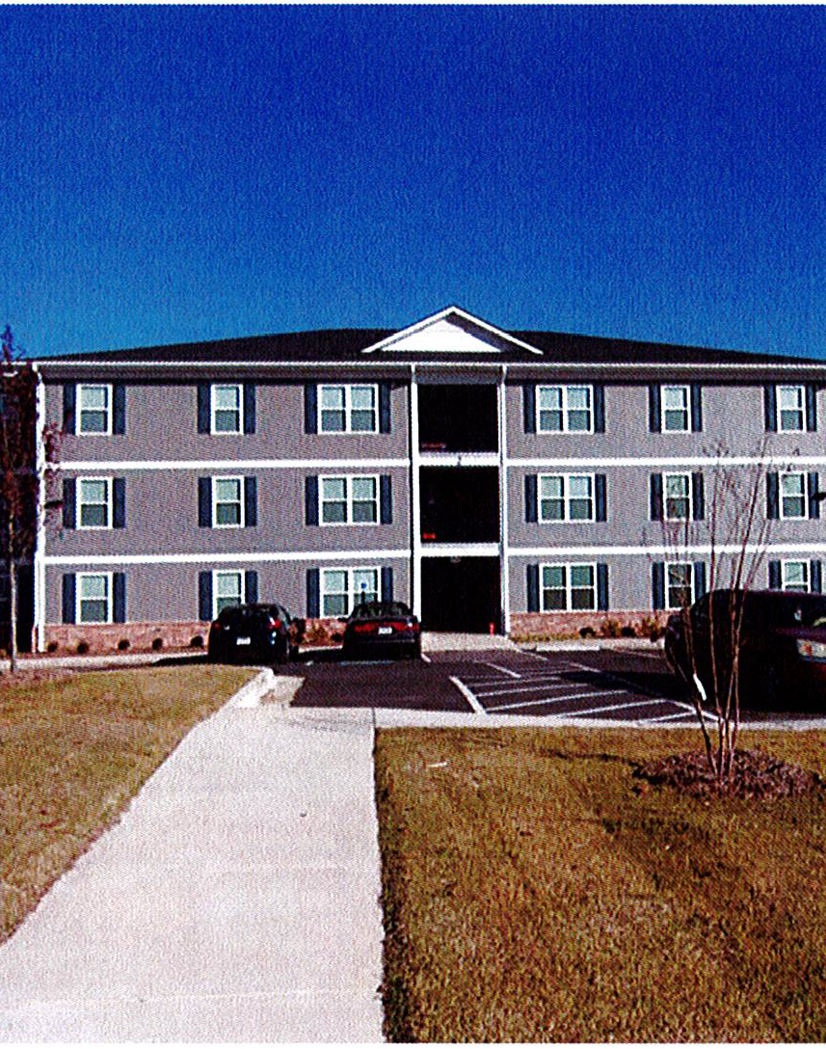
HOME Home Investment Partnership Program
The HOME Program was created by the National Affordable Housing Act of 1990 (NAHA) and has been amended several times by subsequent legislation. It is the largest Federal block grant available to communities to create affordable housing.
Objectives. The intent of the HOME Program is to:
Increase the supply of decent affordable housing to lower-income households,
Expand the capacity of nonprofit housing providers,
Strengthen the ability of state and local governments to provide housing, and
Leverage private-sector participation.

Slide 26
HOME Home Investment Partnership Program
ADFA’s Home Program provides financing for Multi-Family Rental Projects,
Single Family Home Construction, and Tenant Based Rental Assistance.
Multi Family Rental New Construction
Multi Family Rental Acquisition/Rehabilitation
Single Family Homebuyer – Down Payment Assistance
Single Family New Construction – Homebuyer Program
Tenant Based Rental Assistance
https://adfa.Arkansas.gov/programs

Slide 27
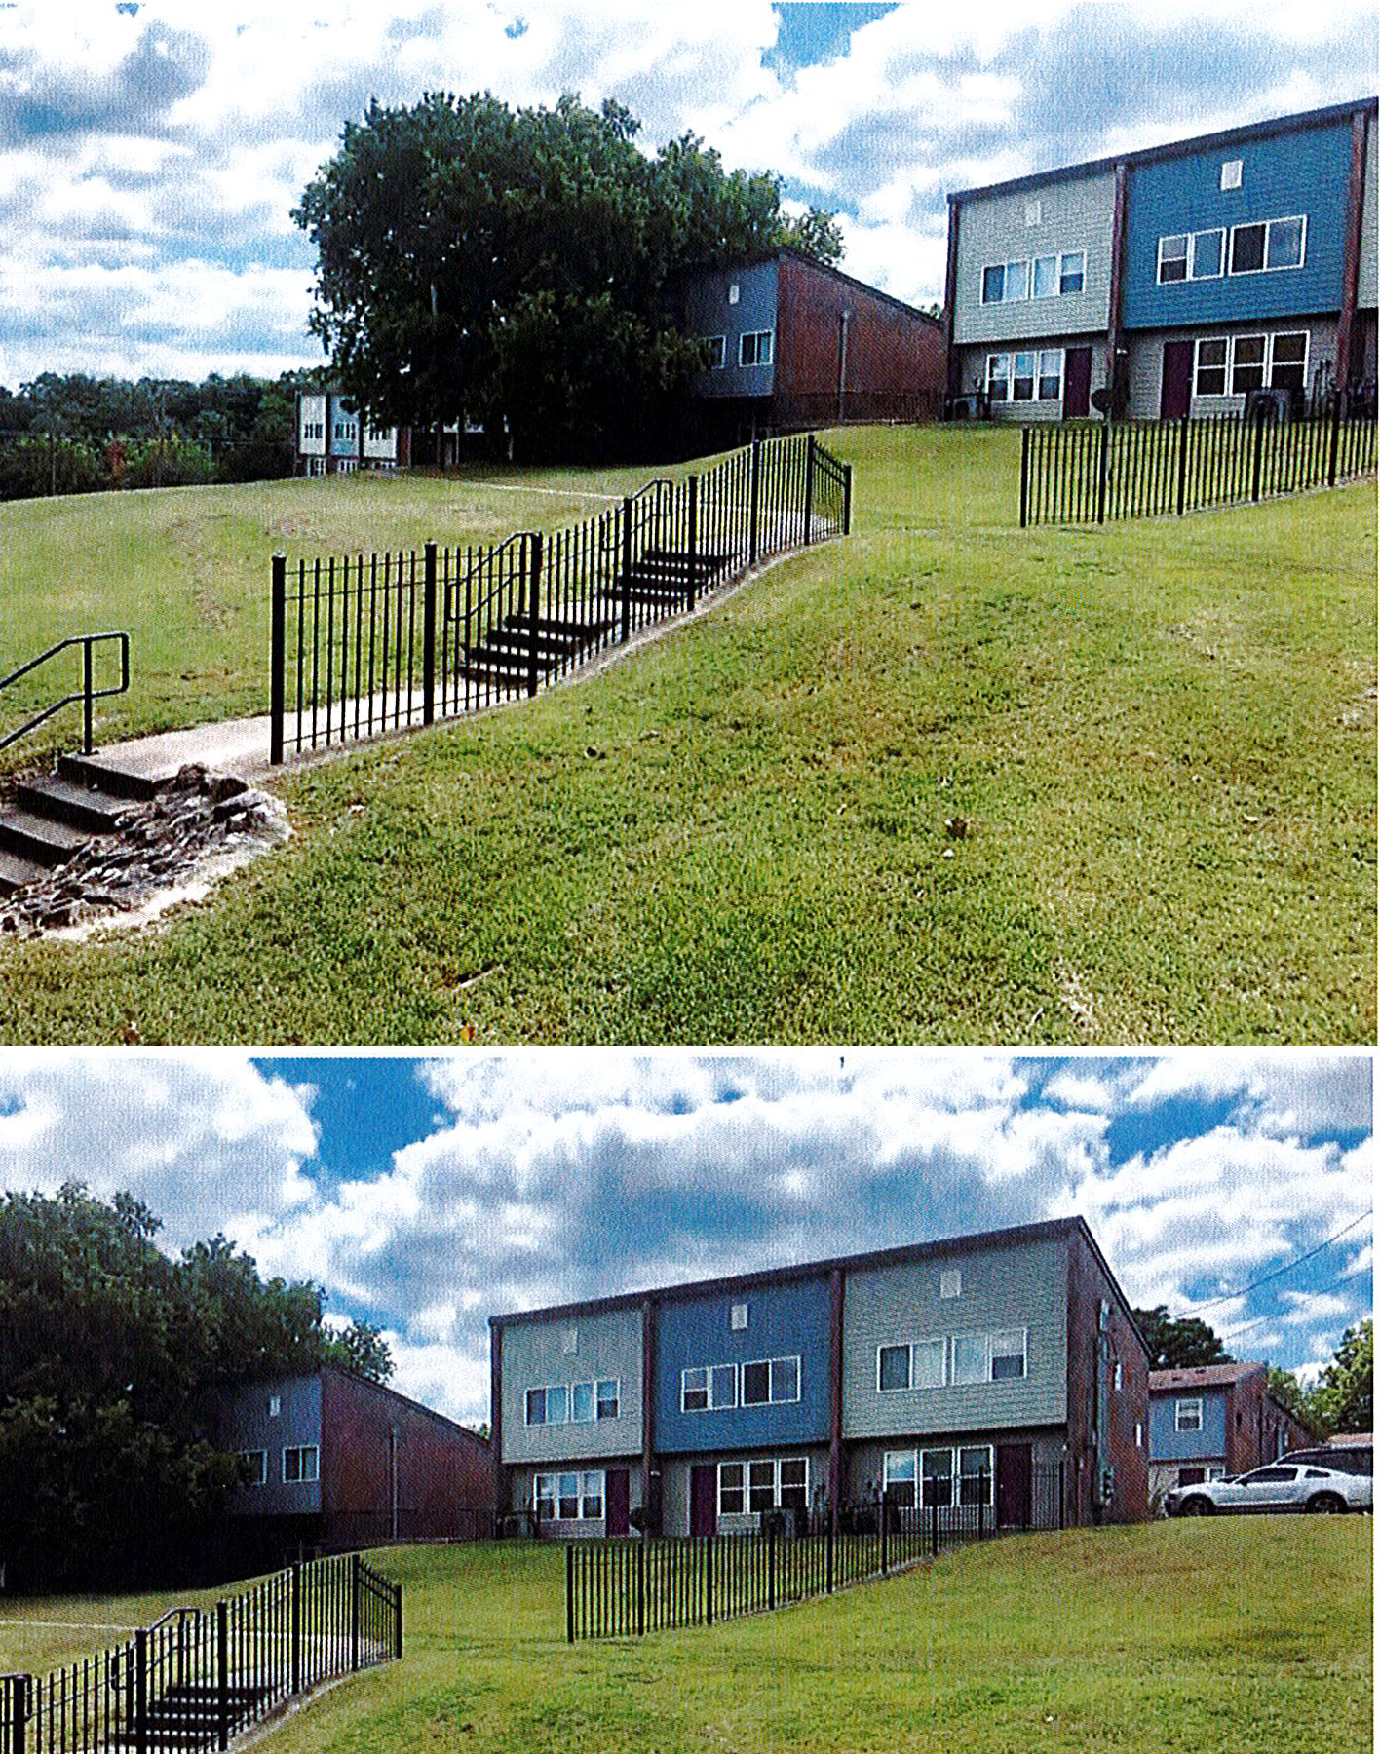
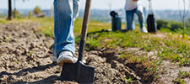
HOME Home Investment Partnership Program
Multi Family Rental New Construction
Multi Family Rental Acquisition/Rehabilitation
With a per-project limit of $2 million, HOME funds are utilized to finance Multi-Family Rental Projects, including new construction and acquisition/rehabilitation.
HOME funds are often combined with other Federal Program Financing tools such as National Housing Trust Fund, and Low-Income Housing Tax-Credits (LIHTC), to construct or rehabilitate Multi-Family Rental Housing Units.
HOME funding creates incentives for Private Participation through its MATCH requirements. MATCH can include donations such as: land, cash, professional services, construction materials and/or appliances, as well as sweat equity through volunteer participation.
https://adfa.Arkansas.gov/programs

Slide 28
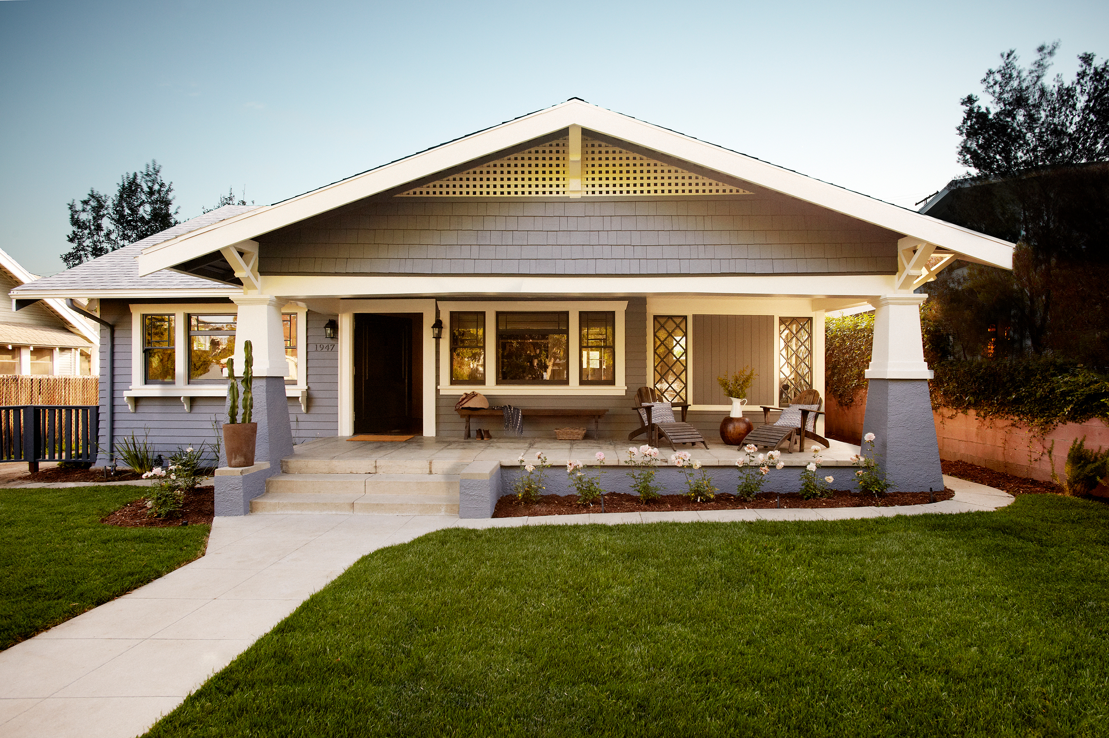
HOME Home Investment Partnership Program
Single Family Homebuyer – Down Payment Assistance
Additionally, ADFA provides down-payment assistance through its Arkansas Dream Down Payment Initiative Program (ADDI), to Arkansas qualified lower income homebuyers, not to exceed $25,000. It is a second mortgage loan with no monthly payment that is forgivable over five years.
Single Family New Construction – Homebuyer Program
ADFA’s Single Family New Construction – Homebuyer program allows for development of new construction homes and provides direct assistance to eligible homebuyers in the form of mortgage subsidies.
https://adfa.Arkansas.gov/programs

Slide 29
HOME Home Investment Partnership Program
Tenant Based Rental Assistance
Qualified subrecipients such as Housing Authorities, Community Housing Development Organizations (CHDO’s), or Non-profit Housing Providers, may apply for Tenant Based Rental Assistance (TBRA). TBRA aids low-income households enabling them to rent the unit of their choice.
ADFA’s HOME-funded Tenant-Based Rental Assistance Program was designed to address one of the most prevalent affordable housing problems experienced by medium and small-sized communities in the State of Arkansas, the need for rental assistance for low-income persons.
The most common type of TBRA provides payments to make up the difference between the amount a household can afford to pay for housing and local rent standards.
Other TBRA programs help tenants pay for costs associated with their housing, such as security and utility deposits. (However, under the HOME Program, utility deposit assistance can only be provided in conjunction with rental assistance programs or security deposit programs.)
https://adfa.Arkansas.gov/programs

Slide 30
NHTF National Housing Trust Fund
The National Housing Trust Fund (“NHTF”) is a new affordable housing production program that will complement existing federal, state and local efforts to increase and preserve the supply of decent, safe and sanitary affordable housing for extremely low-income (“ELI”) households, which are defined as households at or below 30% of area median income (“AMI”).
ADFA will administer the NHTF program to provide funds to develop new construction or rehabilitate existing structures to create decent, safe, and sanitary rental housing, primarily targeting a specific underserved group: The ELI population in Arkansas.
Preference will be given to ELI Veterans
With special needs
Who are homeless or may become homeless
With mental health issues, and/or
Who are leaving correctional facilities
Preference will also be given to surviving spouses of deceased Veterans.
https://adfa.Arkansas.gov/programs

Slide 31
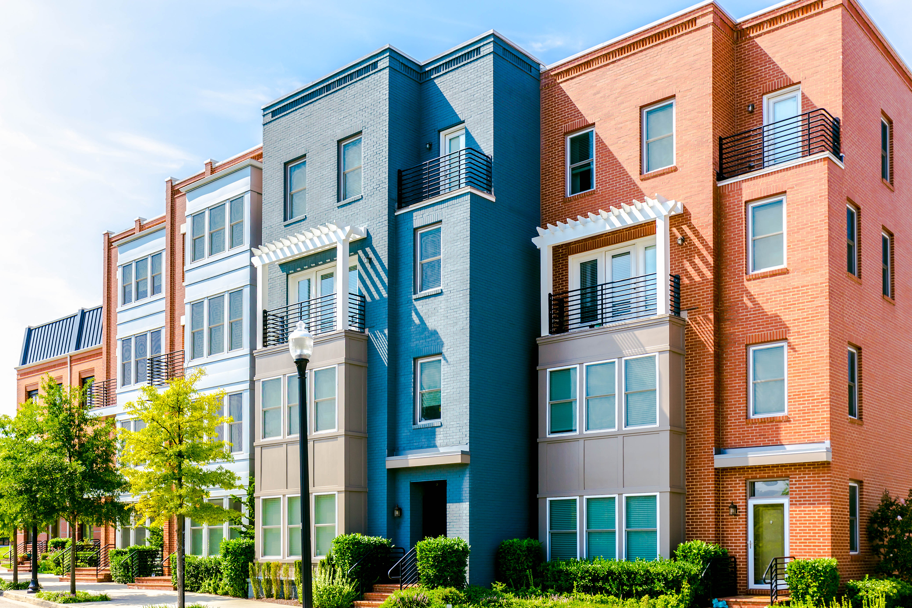
HOME
In Fiscal Year 2021 – ADFA funded $9,412,848.70,
in Multi-Family, Single-Family, and TBRA Programs
NHTF
In Fiscal Year 2021 – ADFA funded $6,336,403.59,
In Multi-Family Programs
Contact:
Lori Brockway, Federal Housing Programs Manager
501-682-3339
Lori.Brockway@Arkansas.gov
https://adfa.Arkansas.gov/programs

Slide 33
ESG Funding for FY 2022-23
$2,261,347.00
Any Remaining Funding from prior years upon HUD approval

Slide 34
Emergency Solutions Grant Funding
FY 2022 (October 2022– September 2023)
$2,264,323
Street Outreach 0.50% $11,306.73
Emergency Shelter 45% $1,017,606.15
Homeless Prevention 23% $520,109.81
Rapid Re-Housing 24% $542,723,28
Administration 7.50% $169,601.03
41 AGENCIES AWARDED

Slide 35
Emergency Solution Grant Components
Street Outreach
Shelter
Rapid Re-Housing
Homeless Prevention (30% income Limit)
Administration
Match Requirement

Slide 36
Decisions In July
Agencies notified

Slide 37
ESG Program Monitoring
OCS Desk Monitoring
OCS Monitoring Tool

Slide 38
Questions
Contact Information
Lorie Williams
501-682-8714 W
501-258-5992 C
Lorie.Williams@dhs.Arkansas.gov

Slide 39
HIV/AIDS AND HOUSING
ARKANSAS’ HOPWA PROGRAM
2022-23

Slide 40
HIV in Arkansas
As of December 31, 2017, there were 6,087 persons living with HIV in Arkansas.
2019: Arkansas is ranked among the seven (7) states with high HIV incidence.
Number of PLWHA needing housing assistance ≈ 134@
Non-HIV family persons benefiting from housing assistance ≈ 90@

Slide 41
Why HOPWA?
“…Homelessness, HIV disease, and access to health care are fundamentally interconnected….”
ADH HOPWA Fact Sheet, 2011
“Housing is Healthcare…and offers the best opportunity for PLWHA to access therapy….[Yet] housing [remains] the greatest unmet service need for people living with the disease….”
National AIDS Housing Coalition, Rev. 8/ 2009

Slide 42
Arkansas HOPWA Program
The State HOPWA Program works to:
Provide safe, decent, and affordable housing
Increase housing stability and access to services and care, and
Decrease the risk of homelessness

Slide 43
Who are the HOPWA Clients?
Men and Women living with HIV/AIDS
Some are families with children
ALL have a demonstrated housing need AND
Have a current notice of eligibility, after screening

Slide 44
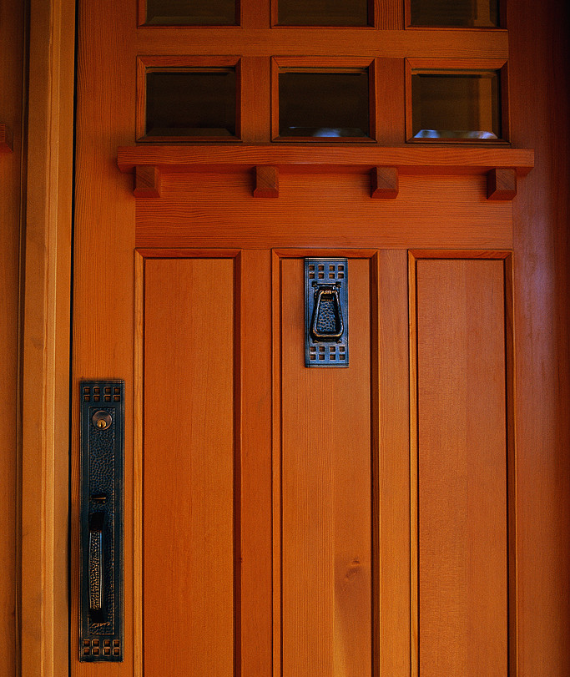
Clients facing competing demands relative to getting basic needs met have problem maintaining care:
Housing
Food
Child-care
Therefore, it is important to reduce barriers that impede access to services; affordable, accessible housing is one of such barrier.

Slide 45
HOPWA IN ARKANSAS
HOPWA’s grant for the State of Arkansas is administered by Arkansas Department of Health.
The Grant is Formula-based: calculated based on HIV/AIDS surveillance data: “…cumulative AIDS cases and area incidence…”
Funding provides our State with resources for meeting the housing needs of low-income persons living with HIV/AIDS and their Families.

Slide 46
Housing assistance for eligible clients will:
reduce risks of homelessness
increase access to appropriate healthcare and other support
Our priority population: HIV/AIDS clients with incomes ≤ 80% of the AMI for the area in which they live (determined by the U.S. HUD)

Slide 47
ADH HOPWA
SERVICE
AREA

Slide 49
As a state Arkansas provides services in 68 of its 75 counties
Crittenden County in Northeast Arkansas is covered as part of the Memphis Eligible Metropolitan Statistical Area (EMSA)
ADH, as Grantee, administers HOPWA activities in 68 counties: Districts 1, 2, 3, 4, & 6 [see map]
District 5 HOPWA under separate grant administered by City of Little Rock (6 counties).
ADH, now provides HOPWA assistance across jurisdictional lines to District 5 and Crittenden County based on need and funding availability.

Slide 50
Project Sponsors
ADH administers HOPWA through non-profit agencies called Project Sponsors.
Currently there’s just one.
Northeast Arkansas Regional AIDS Network (NARAN)

Slide 51
Services Description and Categories
I. Administration:
- Grantee-3% of Federal award
- Project Sponsors- 7% of subgrant award for management, oversight, coordination, evaluation, reporting, etc.
II. Direct Housing Services: 63.0%
(i) Tenant-Based Rental Assistance (TBRA): housing subsidy provided for use on the open rental market.

Slide 52
Services Description/Categories Cont’d
(ii) Short-Term Rent, Mortgage, & Utility Assistance (STRMU):
prevents homelessness of mortgage holder or renters already housed; allows assistance for up to 21wks in any 52wk period.
(iii) Facility-Based Rental Assistance (FBRA)*
Hotel/motel voucher assistance for up to sixty (60) days within any six (6)-month period, where rental housing is identified but not immediately available for move-in by approved clients.

Slide 53
Services Description/Categories Cont’d
(iv) Permanent Housing Placement (PHP): assistance with ‘move-in’ cost pays up to two months of rent; one-time security; one-time utility deposit.
*CASE-BY-CASE NEEDS BASED ASSISTANCE TO NON-ADH JURISDICTIONS UPON REQUEST.*
III. Supportive Services: 27.0%
Housing case management, care coordination, home & health assessments, etc.

Slide 54
Expanded Supportive Services 2021-2022
Substance Abuse treatment-short term (≤ 120dys)
Basic Telephone Service: intended to assist beneficiary in accessing services
Child Care (does not include childcare while beneficiary is at work.)
Transportation: to assist beneficiary access health care services or housing.
Meals/Nutritional Services: actual meals or nutritional supplements; essential hygiene items & household cleaning supplies
Life Skills Management: psychosocial & interpersonal skills; anger management & conflict resolution; communication; budgeting & money management, etc.

Slide 55
Program Goals
Goal 1: Provide housing assistance and appropriate supportive services to enable clients to remain in their homes and to reduce their risks of homelessness.
Goal 2: Improve access to health care and other supportive services

Slide 56
Housing Barriers that Clients Face
Major barriers to accessing affordable, stable housing:
Criminal justice history
Rental history
Credit history
Housing availability
Housing affordability
Multiple diagnoses/mental health issues
HOPWA/HUD regulations
Rent determination & Fair market rents

Slide 57
Funding Breakdown: based on FY Appropriations
Grantee Admin | $
Project Sponsor Admin | $
TBRA & STRMU | $
PHP | $
FBRA | $
Support Svs | $

Slide 58
Program Contacts
Dr. Cinthia Castro-Ryan White Part B & ADAP Manager
501-661-2682
Dr. Saima Majid, HOPWA Coordinator
501-661-2137

Slide 59
QUESTION & ANSWER
Public comments

Slide 60
2022 Action Plan Schedule
30 Day Public Comment Period
April 3, 2022 – May 3, 2022
Public Hearing April 14, 2022
Submission to HUD for Approval
May-July 2022 (pending appropriation announcement)
Funding available
July 1, 2022 – June 30, 2023
Jean Noble, PCED
Director, Grants Management
(501) 682-7389 JNoble@ArkansasEDC.com
Plan Available for Review at:
www.ArkansasEDC.com/Grants

