Slide 1

Welcome to the ESO Call!
10am -11am CT
First Wednesday of Each Month

Slide 2
January ESO Call Agenda
I. Welcome
II. New Member Introductions
Please introduce yourself and let us know how we can connect with you.
III. Community Announcements
IV. Entrepreneurial Spotlight
Robin Atkinson, Founder and CEO, Upkept

Slide 3





Considerations
We begin promptly at
10am CT on the ﬁrst Wednesday of each month. Calls are limited to one hour.
Meetings are recorded and will be made available upon request.
Please mute your microphones unless speaking.
If you have an announcement, please make sure you send it in our announcement link on our website.

Slide 4

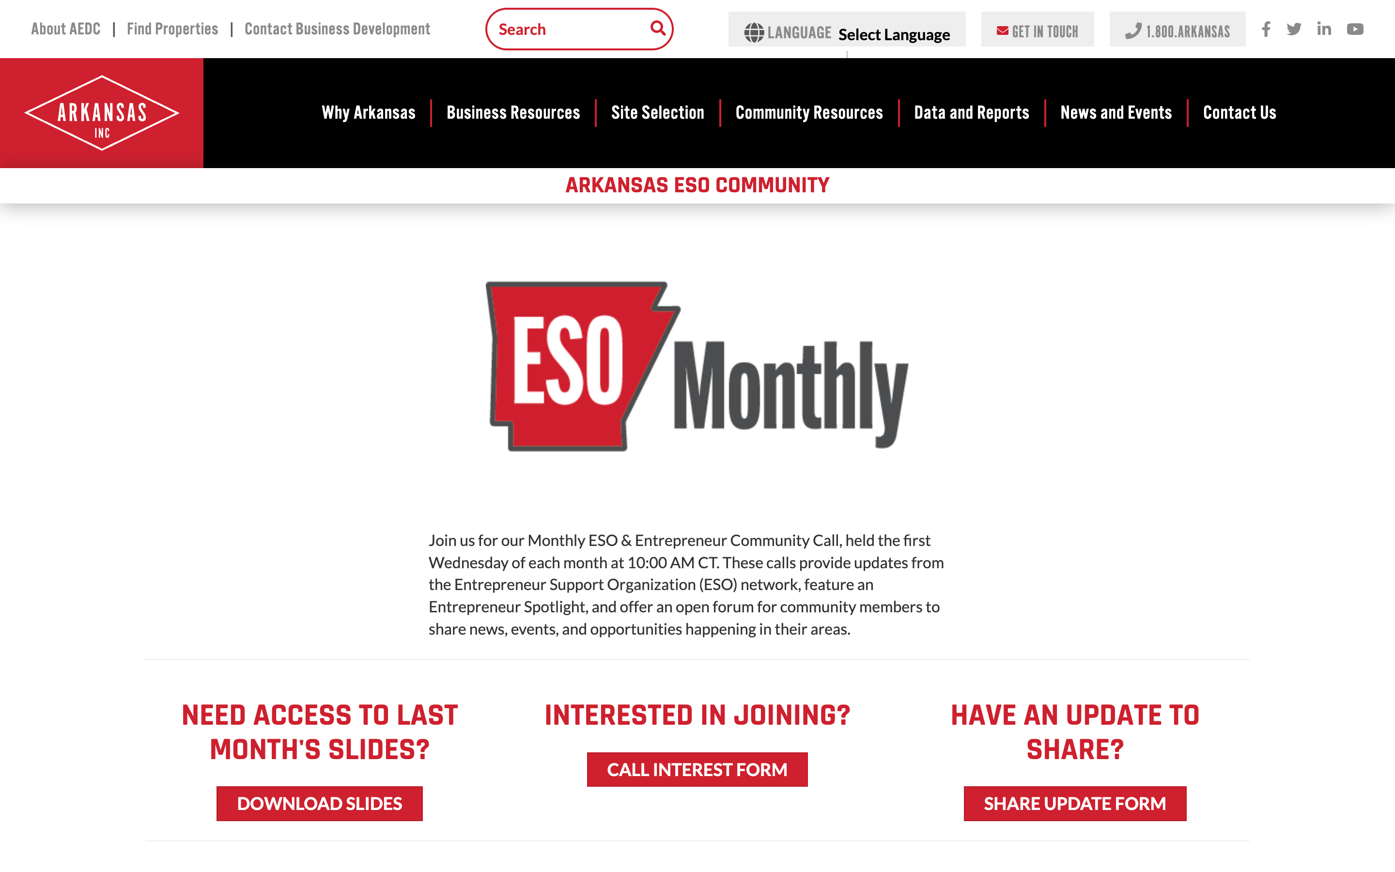
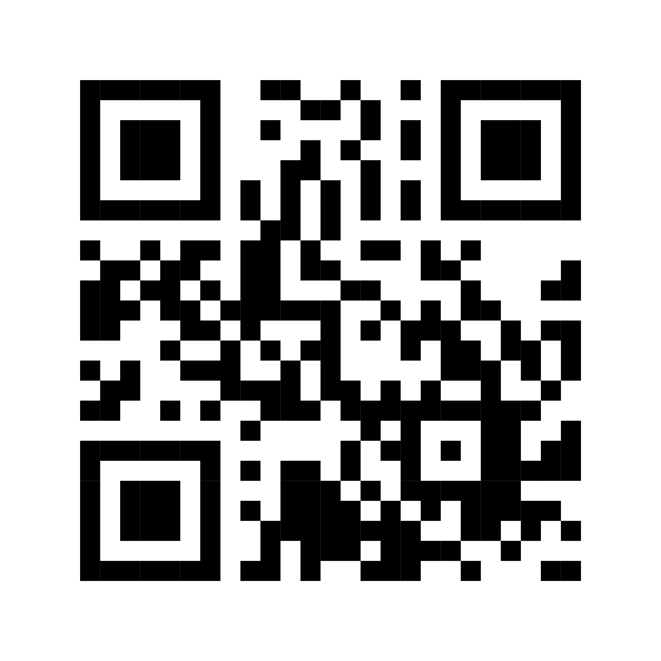
ESO Call Landing Page
A central location where you can find important links such as the call’s joining link, community updates, the previous ESO slide deck, and more.
If you have questions or concerns, please contact:
Mallory Race, Senior Project Manager
Arkansas Economic Development Commission
Mallory.Race@ArkansasEDC.com
bit.ly/AR-ESO

Slide 5
New Member Introductions

Slide 6


January 2026
Community
ANNOUNCEMENTS

Slide 7
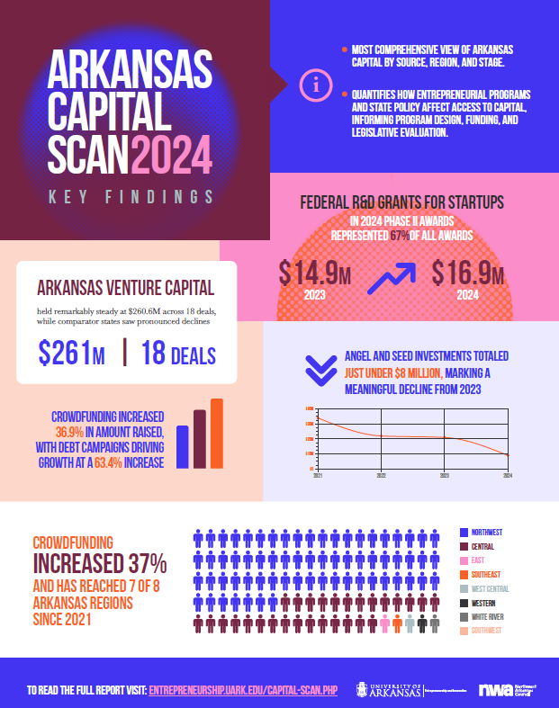

Slide 8


Slide 9



Slide 10









Connecting startups with community partners in Northwest Arkansas for funded pilot projects addressing real-world challenges.
FOCUS AREAS
Population Health & Health Equity
Mental & Behavioral Health
Environmental Sustainability
Economic Vitality
HOW YOU CAN HELP
Startup Referrals: Know companies with solutions in the focus areas? Send them our way!
1
Community Partners: Know NWA organizations interested in partnering on pilots? Introduce us!
2
CURRENT COMMUNITY PARTNERS

Slide 11






Ozark Retail Accelerator is designed to provide Arkansas-based CPG companies practical tools for large retail operational readiness.
Over 12 weeks, founders gain hands-on access to retail operators, former buyers, and category leaders who have built, scaled and launched suppliers inside some of the largest omnichannel retailers in the world. The workshops will include buyer presentations, supply chain & packaging, retailer systems, retail media marketing, omnichannel planning and so much more.
Ideal candidates are ready for scale with the following attributes:
Consumer Packaged Goods (CPG) product
Ready to scale to Large Regional/National Retailers
Arkansas-based or Arkansas-committed
Real product in market with sales
Willing to invest the time into learning and growing
Apply by February 15: ozarkretailaccelerator.com
Questions: phils@uark.edu or info@ozarkretailaccelerator.com

Slide 12

GORP is back….
The Greenhouse Outdoor Recreation Program (GORP) is an incubator for early-stage outdoor recreation startups. Through in-person weekly evening workshops, GORP provides the tools to confirm your business model and move quicker to launch with a better chance of success.
Companies receive:
Weekly cohort training sessions – Tuesdays (March 3-May 19)
Dedicated Mentors
Access to GORP Alumni & Community Network
Dedicated UA Internship Support
Product/Service Development Support
Up to $15,000 of non-dilutive funding
Apply by February 9: GORP.uark.edu (opens Jan 9)
Questions: Ask Windy - windye@uark.edu

Slide 13
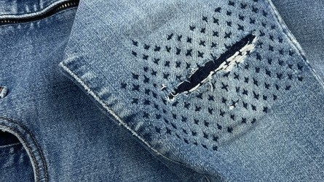
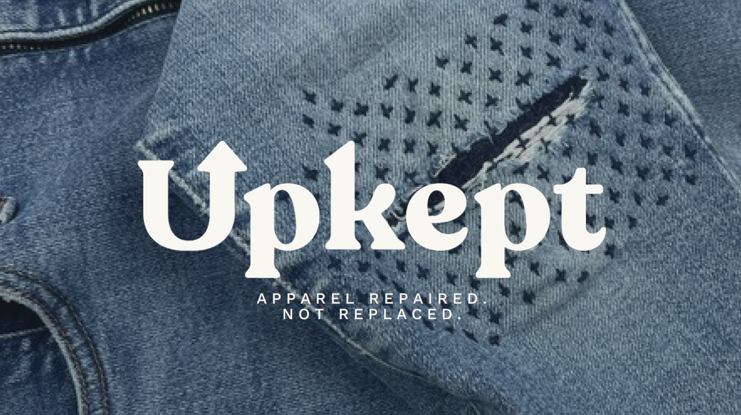

A P P A R E L
R E P A I R E D .
N O T R E P L A C E D .

Slide 14


PURPOSE
WE KEEP THE CLOTHES YOU LOVE — REPAIRED,
NOT REPLACED.
Upkept makes garment repair effortless, affordable, and nationwide. A modern repair movement built for people who want smarter options, not more stuff.

Slide 15
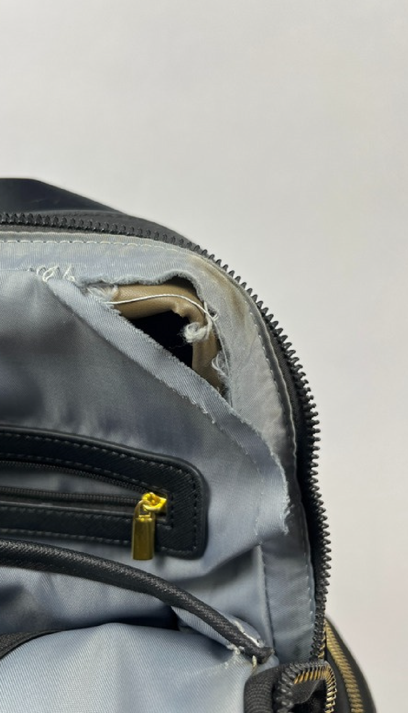
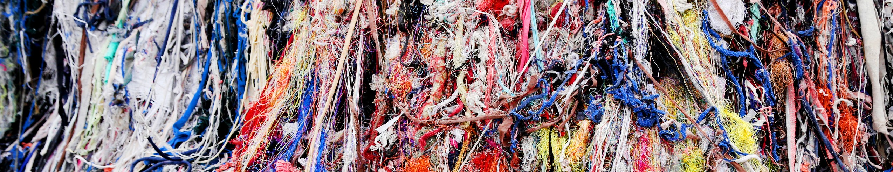
PROBLEM
THE REPAIR SYSTEM IN AMERICA HAS COLLAPSED.
17M tons of textiles are discarded annually — 20–40% repairable. 75% of brands offer zero post-purchase support.
The tailoring workforce is shrinking — 13% exiting year over year. Consumers already spend $4–6B on repairs, but access is fragmented and outdated.
Consumers want to repair — they just have nowhere to turn.

Slide 16
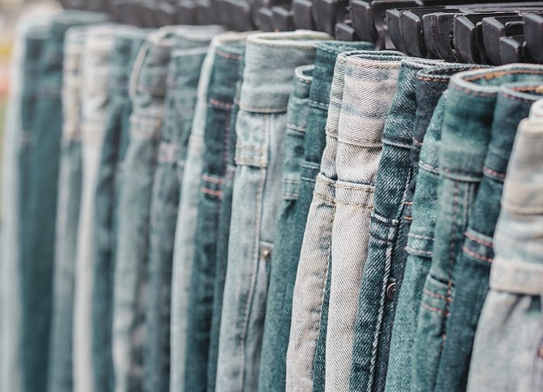

SOLUTION
A FRICTIONLESS REPAIR EXPERIENCE
Snap → Upload → Ship → Repair → Return.
AI-powered quoting engine gives accurate pricing in seconds.
Regional hubs reduce shipping time + cost. Fairly paid workforce ensures consistent quality.
Brand-agnostic: we repair any garment, any brand.
A full-stack platform bringing repair into the modern era.
A F F O R D A B L E ,
S U S T A I N A B L E ,
A N D A C C E S S I B L E
— F O R E V E R Y
C L O S E T I N A M E R I C A .

Slide 17
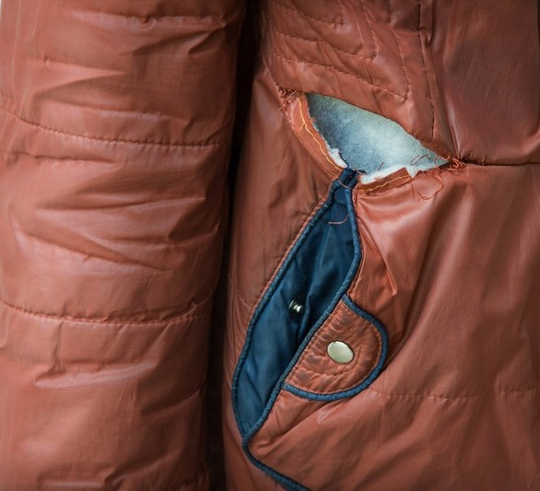
REPAIR IS BECOMING MAINSTREAM — BUT
NO ONE HAS BUILT THE NATIONAL
INFRASTRUCTURE.
Demand is rising: 76% of consumers say they would use repair services.
No dominant, tech-enabled U.S. repair brand. Tailoring labor is disappearing while clothing waste hits record levels.
Early traction shows strong organic pull for a modern, convenient solution.
The U.S. is overdue for a scalable repair platform — Upkept is building it.
WHY NOW

Slide 18
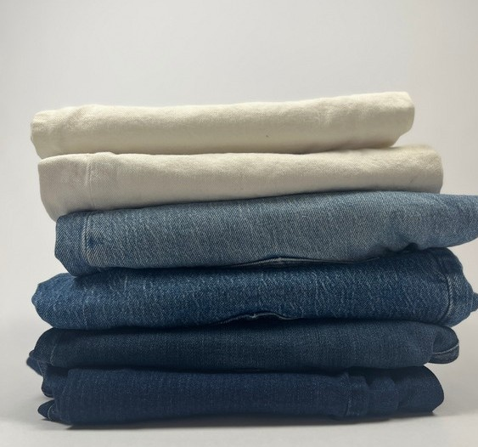
A^{M}MA^{A}SS^{R}IV^{K}E, U^{E}NT^{T}AP^{S}PE^{I}D^{Z}CA^{E}TEGORY.
TAM — $11.3B
If every U.S. adult repaired just two items a year, the market reaches $11.3B — showing how large the category becomes once repair is normalized.
SAM — $1.1B
The digitally reachable, high-intent consumers already looking for convenient repair options today — a segment primed for adoption as the first national platform emerges.
SOM — 1% Penetration = $10–12M
Capturing just 1% of reachable consumers drives $10– 12M in annual revenue, even before broader cultural shifts accelerate category growth.
A national opportunity with no market leader. Demand is rising, but infrastructure doesn’t exist; positioning Upkept to define and own the modern repair market.

Slide 19
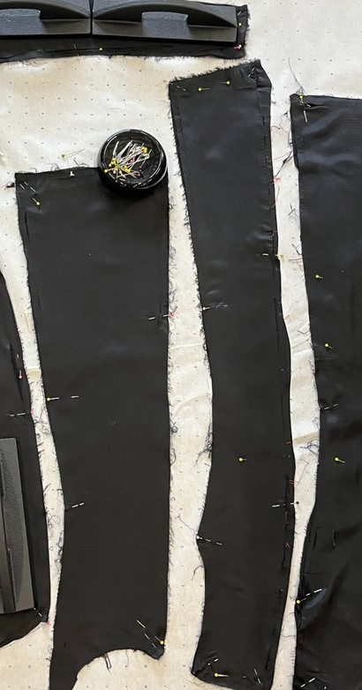
COMPETITION
A FRAGMENTED LANDSCAPE WITH NO CLEAR WINNER.
Local tailors: limited capacity, inconsistent quality, no tech. Brand programs: only a handful offer repair; most outsource or avoid it.
DIY platforms: not convenient, not scalable.
Upkept is the first full-stack, DTC-first, nationwide repair platform — built for modern consumers.
MARKET GAP:
ONLY SCALABLE, AFFORDABLE, BRAND-AGNOSTIC APPAREL REPAIR PLATFORM IN THE U.S.; COMPETITORS REMAIN LOCAL, BRAND-SPECIFIC, OR LOW-TECH.

Slide 20
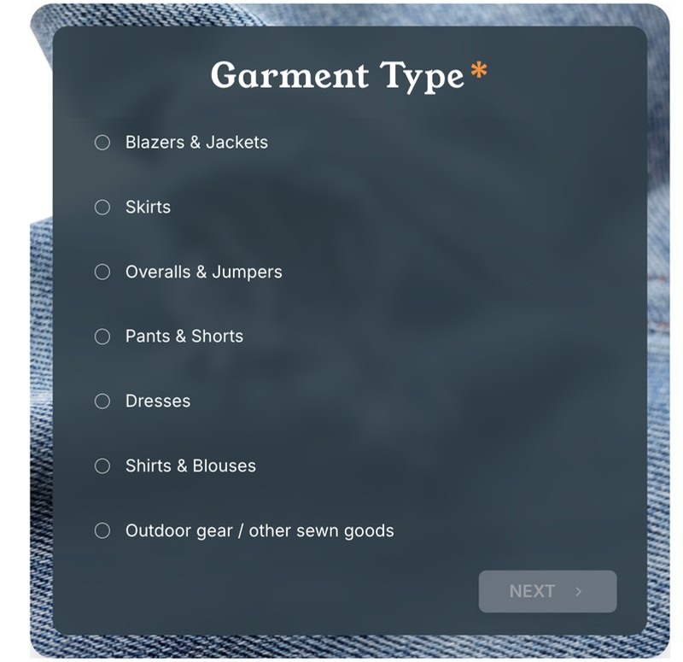
PRODUCT
THE SIMPLEST WAY TO KEEP YOUR CLOTHES
IN PLAY.
Product Flow:
Upload photos
Get instant pricing
Ship with prepaid label
Repaired in regional hub
Delivered back looking new
Strengths
Transparent, instant pricing Full-stack quality control
Works for any garment, any brand Designed for repeat behavior

Slide 21
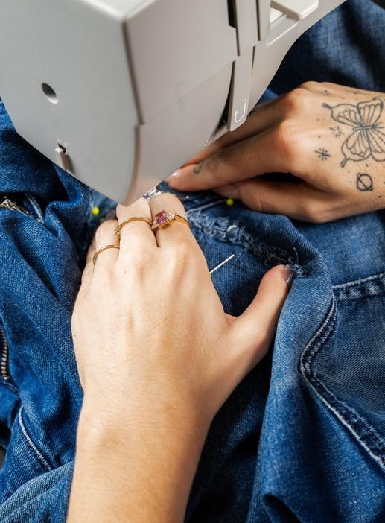
MULTIPLE REVENUE STREAMS, BUILT
FOR RETENTION.
DTC Repairs — AOV ~$37.50
Everyday hems, mends, zippers, and gear fixes that drive consistent volume. Operational and generating revenue.
Upkept Extend
Service agreements added at point of sale - Piloting in 2026
B2B Repair (Brand + Resale Ecosystem)
White-label repair for brand partners and resale platforms—offering reliable volume, standardized quality, and scalable infrastructure they can’t build in-house. Operational and generating revenue.
Subscription — $12/mo
Monthly credits and discounted rates that encourage repeat behavior and create predictable consumer revenue - Piloting 2026
Target Behavior:
60%+ annual repeat; ~2.5 repairs per customer per year.

Slide 22
WWW.UPKEPT.IO
FOUNDING TEAM
FOUNDING REPAIR TEAM
REPAIR DIRECTOR
Victoria Gibbs Salazar Overseeing Quality Control, Training and day to day repair operations
MARKETING TEAM
DTC Marketing Strategist Kristi Klemm
Expertise: Early Groupon, DTC expert, ad optimization
FOUNDER & CEO
Robin Atkinson
3x founder building the modern repair infrastructure. Led sewn-trades ecosystem development, launched Rapha’s U.S. repair HQ, and built repair programs for mission-driven brands.
REPAIR DESIGNER
Carena Hasara
Fashion designer with engineering and systems background
Marketing Intern Maggie Condict
Content capture, community outreach, trendwatch
TEAM
CUSTOMER & LOGISTICS
Hourly Contract
Co-Founder & CTO/CFO Cash Acrey, PhD
Finance + tech dual operator. Drives financial strategy, models scalable unit economics, and leads the build-out of Upkept’s digital platform and operational systems.
Operations Assistant
Harlynn Lester
Apparel Merchandizing Student
Product Development Intern
Riley Frymark
Apparel Merchandizing Student
TECH TEAM
Hourly Contract
Senior Backend Developer Christopher Hobbs
Model development and refinement, back-end ops systems
Senior UI/UX Engineer Ricky Hanna
Customer journey focus, app and website development

Slide 23
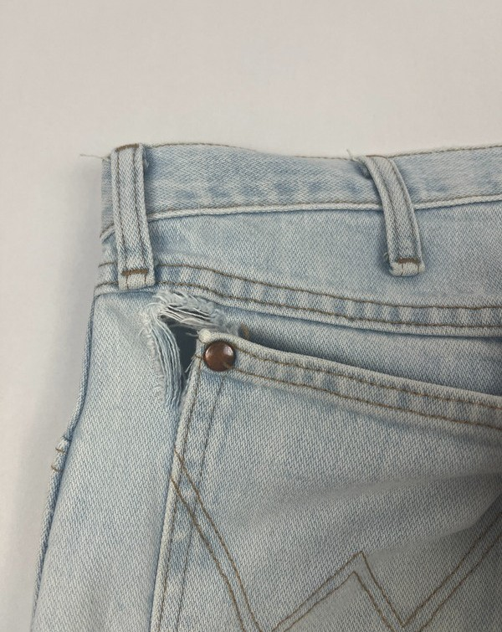
FINANCIALS
EARLY TRACTION WITH A CLEAR PATH TO STRONG
Cur^{M}rent^{A}(De^{R}c 2^{G}025^{I}):^{NS AND SCALE.}
160% month-over-month growth
AOV: $38
1.4 repairs per order Labor: $12.75 per repair Shipping: $6.50 per order Gross Margin: 17%
Target (Sept 2027):
AOV: $39
Labor reduced to 30 minutes per repair Gross Margin: 42%+
Revenue Milestones:
$12,000 revenue to date from DTC + B2B Targeting $100K MRR by December 2027

Slide 24
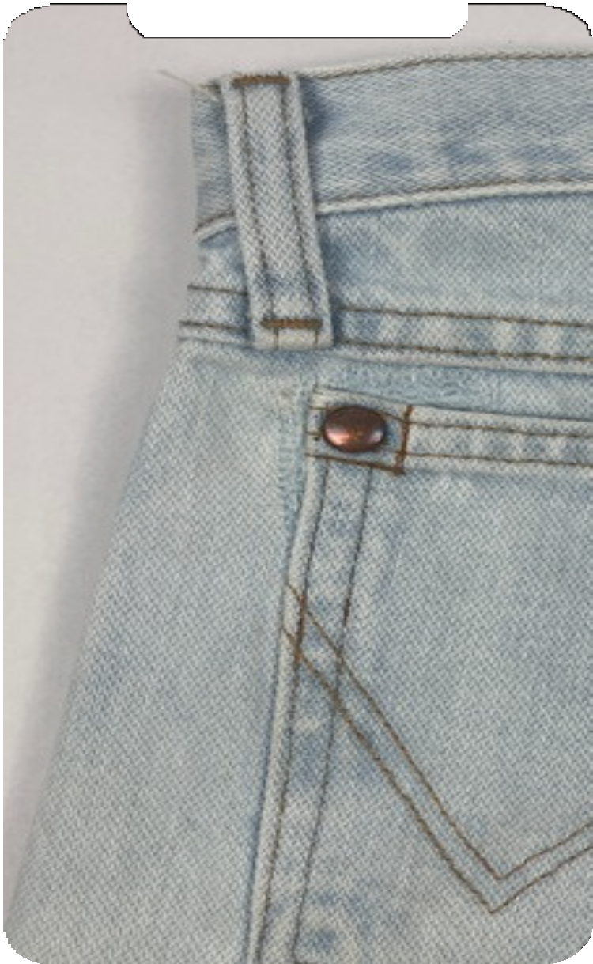
LET'S
CONNECT
Robin Wallis Atkinson
Founder robin@upkeptrepair.com
+1.479.422.7305

Slide 25
^{A}Nati^{P}onal Ass^{P}ociation^{E}of Conve^{N}nience Sto^{D}res. "U.S.^{I}Con^{X}sumers Willing to Pay More for Sustainable Products, Research Shows." Convenience.org, 24 Apr. 2024, https://www.convenience.org/Media/Daily/2024/April/24/4-US-Consumers-Pay-Sustainable_Products_Research.
Earth.Org. "Fast Fashion Waste: Key Statistics and Facts." Earth.Org, https://earth.org/statistics-about-fast-fashion-waste/. Accessed Mar. 2025.
Storr, L. (2023, October 18). ‘The missing link’: Is textile recycling the answer to fashion’s waste crisis? The Guardian. https://www.theguardian.com/fashion/2023/oct/18/the-missing-link-is-textile-recycling-the-answer-to-fashions-waste-crisis Potdar, B., McNeill, L. S., & McQueen, R. H. (2023). An investigation into the clothing repair behaviour of fashion-sensitive consumers. International Journal of Fashion Design, Technology and Education, 17(3), 321–335. https://doi.org/10.1080/17543266.2023.2285327
Norum, Pamela S. "Examination of Apparel Maintenance Skills and Practices: Implications for Sustainable Clothing Consumption." Family and Consumer Sciences Research Journal, vol. 42, no. 2, Dec. 2013, pp. 124–137. Wiley Online Library, https://doi.org/10.1111/fcsr.12047.
"Spotlight Business: Bridge Cleaners and Tailors." Columbia University Mailman School of Public Health, https://www.publichealth.columbia.edu/research/others/age-smart-employer/news/spotlight/bridge-tailors.
Chow, Andrew. "Clothes Piling Up in Your Closet? A Landmark California Bill Would Make It Easier to Recycle Them." The Guardian, 24 Sep. 2024, https://www.theguardian.com/us-news/2024/sep/24/clothes-recycling-california-responsible-textile-recovery-act.
Diddi, Sonali, and Ruoh-Nan Yan. "Consumer Perceptions Related to Clothing Repair and Community Mending Events: A Circular Economy Perspective." Sustainability, vol. 11, no. 19, 2019, p. 5306, https://doi.org/10.3390/su11195306.

Slide 26
CUSTOMER INSIGHTS
EARLY ADOPTERS ALREADY
IN LOVE
Early Reviews:
“I just received my husbands jeans and they look amazing!!! So good and you can’t tell they were ripped!! Where can I leave a review?? Thank you for saving these jeans from ending up in a landfill!!” – Ana M
“I’m so excited Upkept has been created. Unkempt feels like a luxury service that keeps me on my budget. I have a large collection of custom and one of a kind clothing and am overjoyed Upkept is a service I trust with these pieces. It’s easier than DoorDash or orderingin and Uber.
Communication and process are top notch. #ballinonabudget” – Jessica G
CUSTOMER DISCOVERY
Question: If you are interested in online clothing repair, what is your demographic and how would you use the service?
“40s, busy professional that gets rid of no clothing and primarily thrifts clothes. Into fashion, so many of my items are designer I’ve had for years or thrift. So tailoring and mending is important but finding someone to do it is impossible.”
“An introvert.”
“Busy professional here! I love my tailor but she is 30 minutes away and the errand never happens. I want half fixing buttons, taking clothes in and out, and half customizing random pieces I find at thrift stores.”
“Busy mom and RN working loooong hospital hours. No time! And often don’t know how (like broken zippers, adjusting straps, etc.)” “I need this service, please how do we access it?”
“Love this! Price transparency is my biggest issue, is fix going to be
$30 or $130, too scared to find out so don’t go. Sounds like this would be great!”

Slide 27
Thank you for joining us!
See you next month!
Next meeting will be held February 4th at 10 CT

