Slide 1

Welcome to the ESO Call!
10am -11am CT
First Wednesday of Each Month

Slide 2
November ESO Call Agenda
I. Welcome
II. New Member Introductions
Please introduce yourself and let us know how we can connect with you.
III. Entrepreneurial Spotlight
Bea Apple, Founder and CEO of HillFolk
IV. Community Announcements

Slide 3

Considerations
We begin promptly at
10am CT on the ﬁrst Wednesday of each month. Calls are limited to one hour.
Meetings are recorded and will be made available upon request.
Please mute your microphones unless speaking.
If you have an announcement, please make sure you email Mallory.Race@arkansasEDC.com

Slide 4

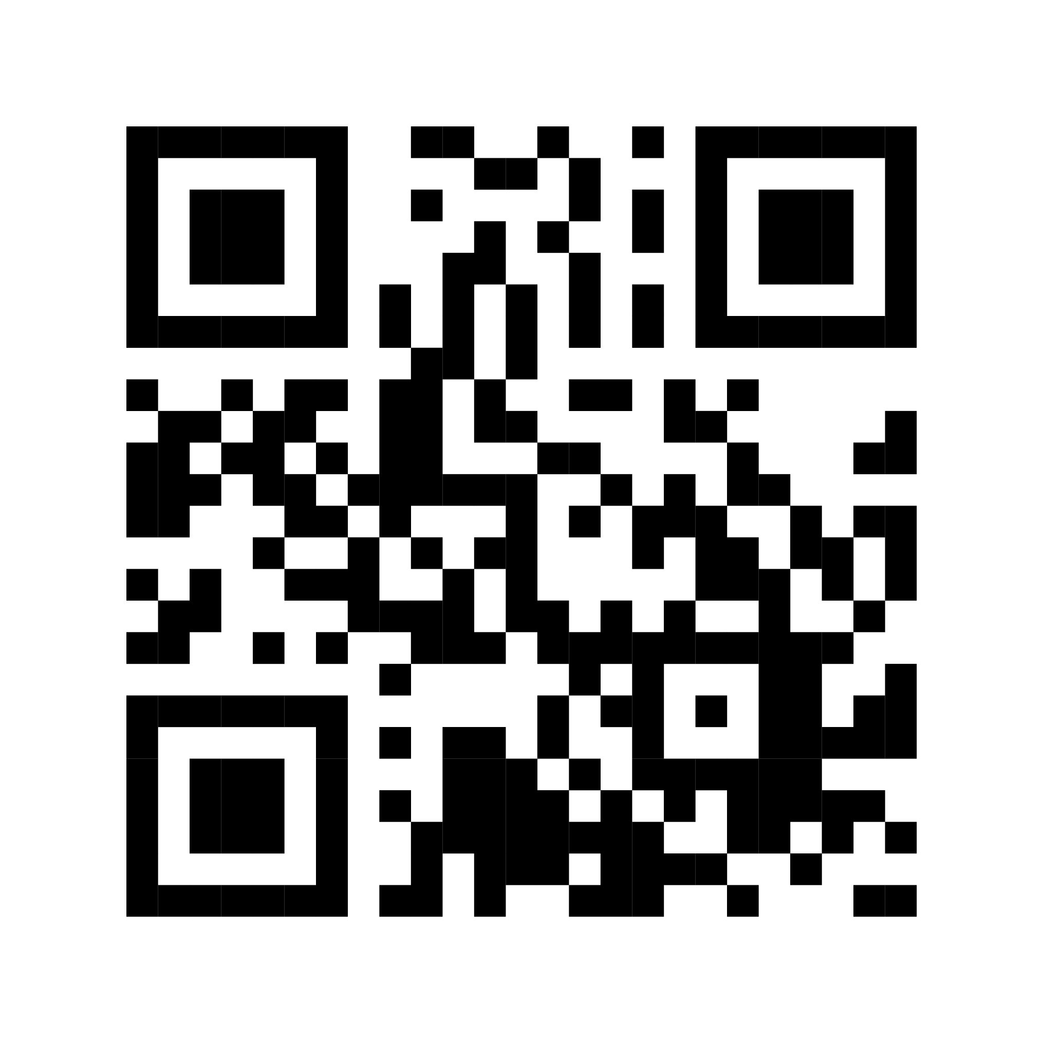
ESO Call Landing Page
A central location where you can find important links such as the call’s joining link, the previous ESO slide deck, and more.
If you have questions or concerns, please contact:
Mallory Race – Senior Project Manager
Arkansas Economic Development Commission
Mallory.Race@ArkansasEDC.com
bit.ly/AR-ESO

Slide 5
New Member Introductions

Slide 6
Entrepreneurial Highlight

Slide 7
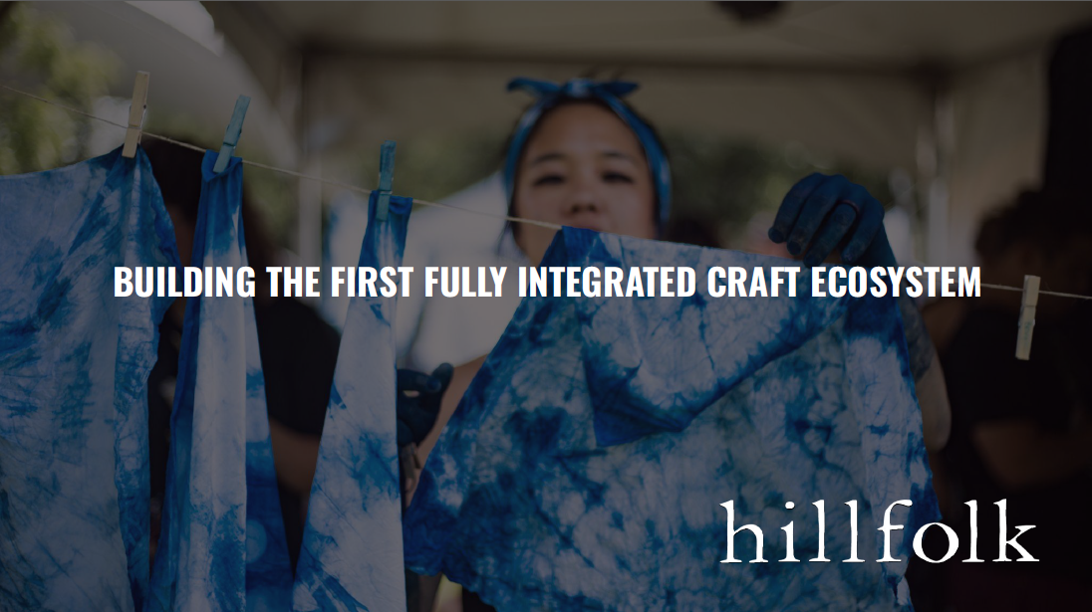

Slide 8
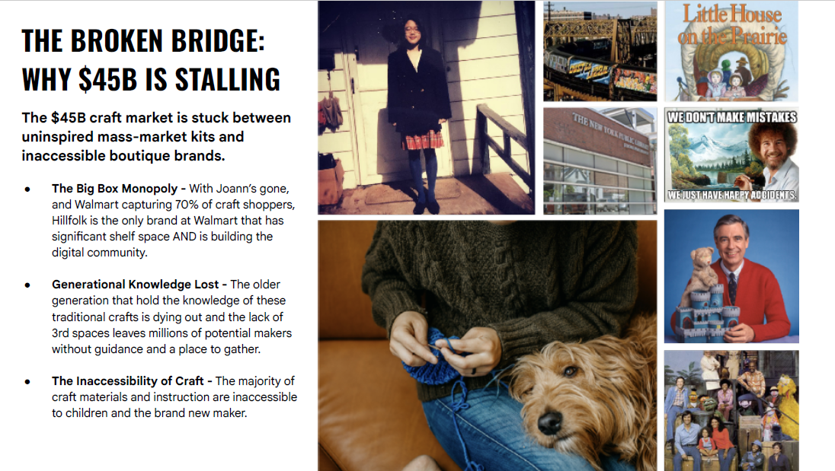

Slide 9


Slide 10


Slide 11
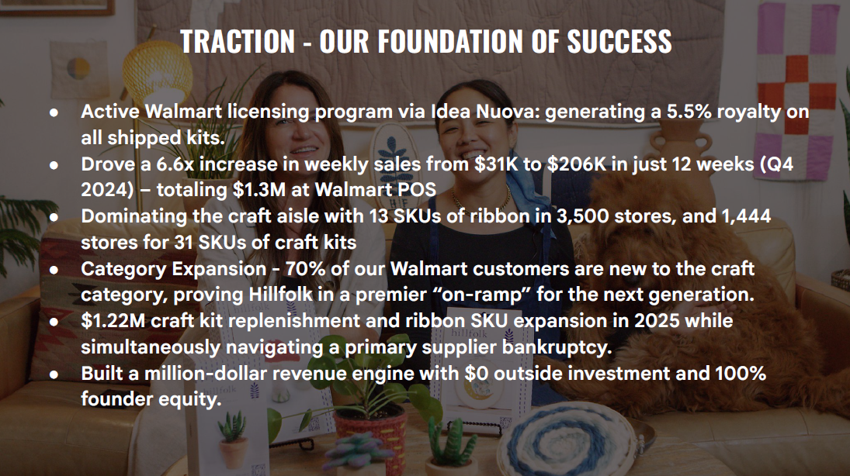

Slide 12
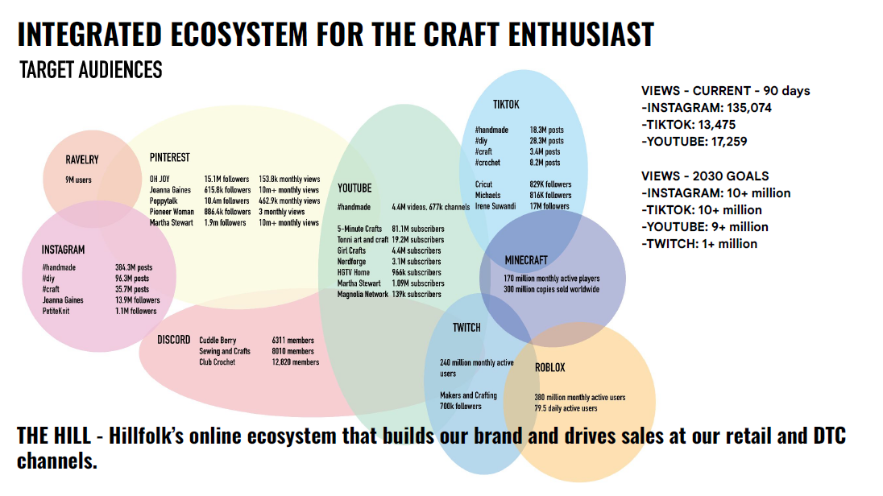

Slide 13
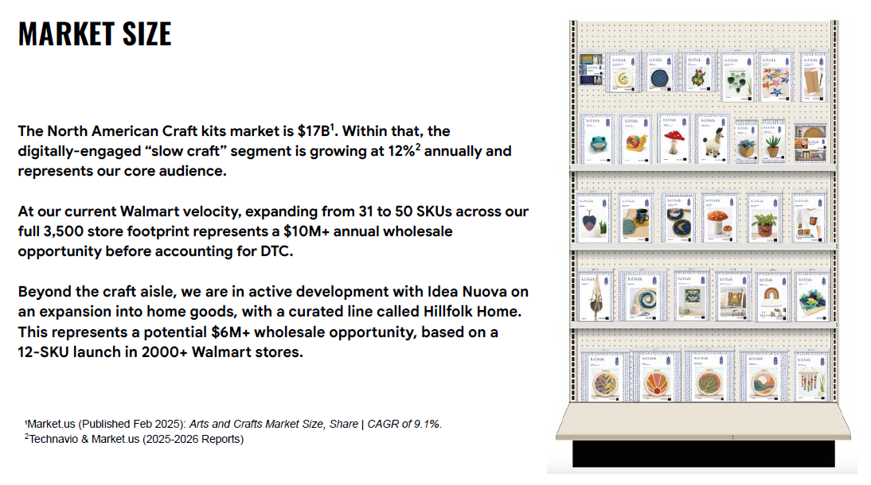

Slide 14
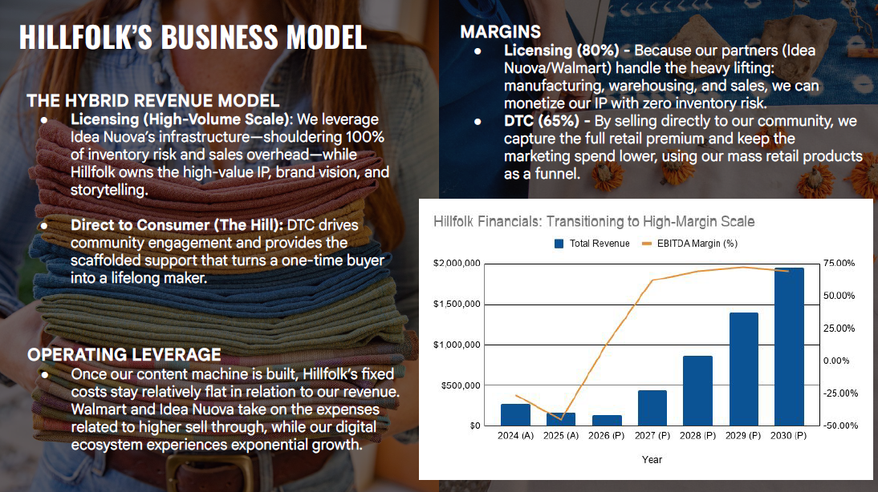

Slide 15
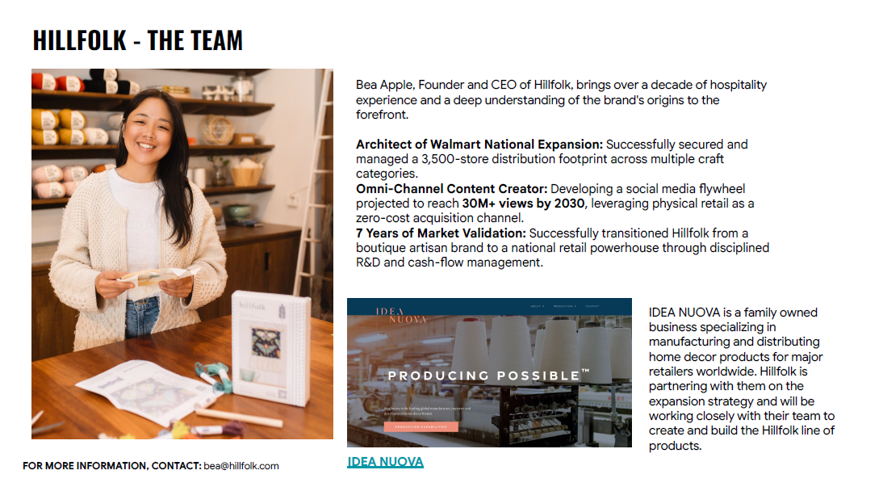

Slide 16


Slide 17


Slide 18


Slide 19

November 2026
Community
ANNOUNCEMENTS

Slide 20
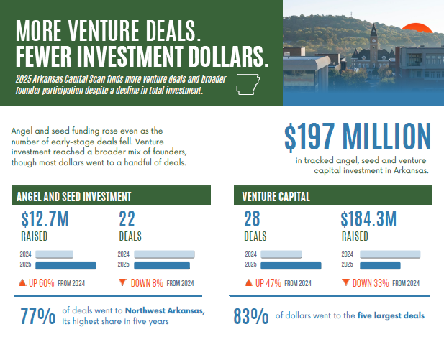

Slide 21
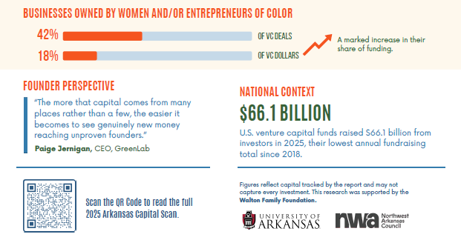

Slide 22


Slide 23


Slide 24


Slide 25


Notes:
https://luma.com/hvc7na54

Slide 26

Notes:
https://luma.com/hvc7na54

Slide 27
Thank you for joining us!
See you next month!
Next meeting will be held December 2nd at 10 CT

