Slide 1

Welcome to the ESO Call!
10am -11am CT
First Wednesday of Each Month

Slide 2
October ESO Call Agenda
I. Welcome
II. New Member Introductions
Please introduce yourself and let us know how we can connect with you.
III. Entrepreneurial Spotlight
Will Hudson, President of Hydro-Temp
IV. Community Announcements

Slide 3

Considerations
We begin promptly at
10am CT on the ﬁrst Wednesday of each month. Calls are limited to one hour.
Meetings are recorded and will be made available upon request.
Please mute your microphones unless speaking.
If you have an announcement, please make sure you email Mallory.Race@arkansasEDC.com

Slide 4


ESO Call Landing Page
A central location where you can find important links such as the call’s joining link, the previous ESO slide deck, and more.
If you have questions or concerns, please contact:
Mallory Race – Senior Project Manager
Arkansas Economic Development Commission
Mallory.Race@ArkansasEDC.com
bit.ly/AR-ESO

Slide 5
New Member Introductions

Slide 6
Entrepreneurial Highlight

Slide 7


Slide 8
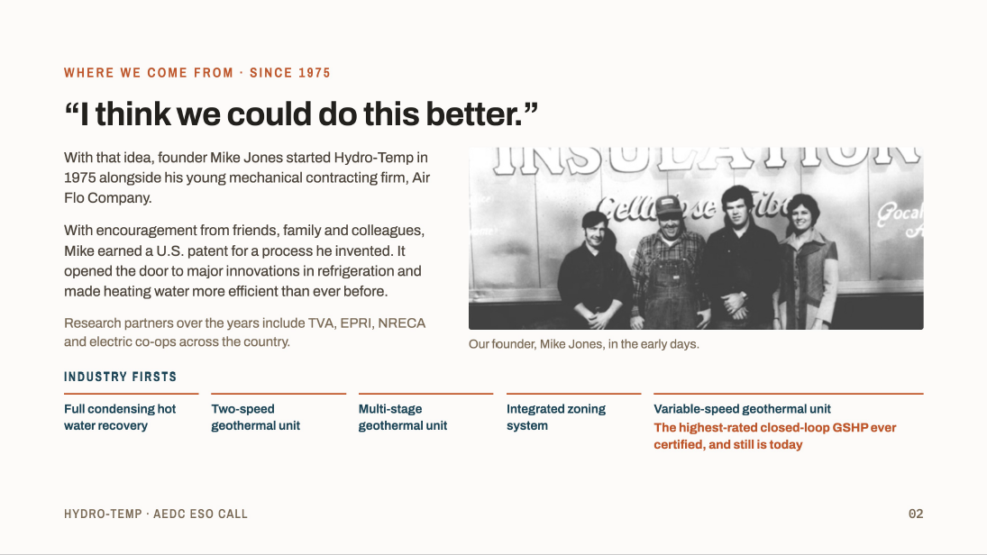

Slide 9
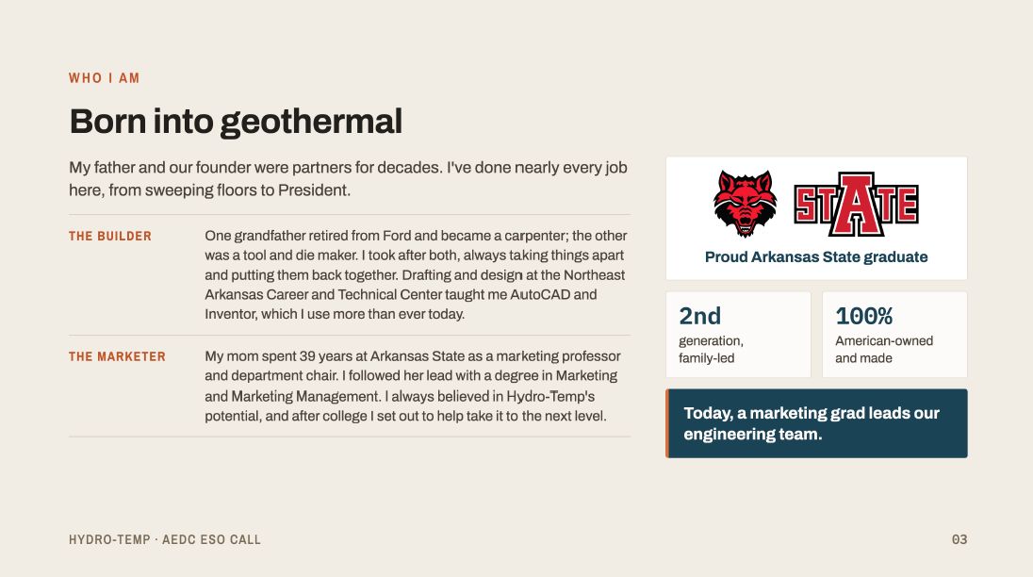

Slide 10


Slide 11
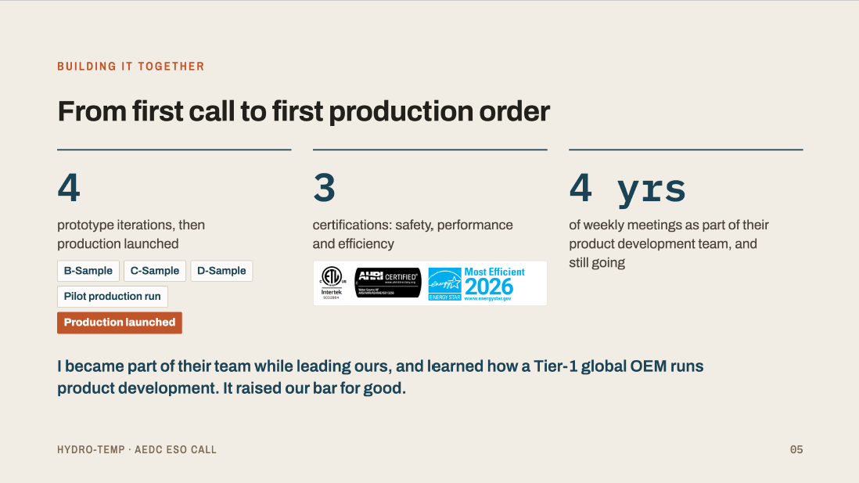

Slide 12
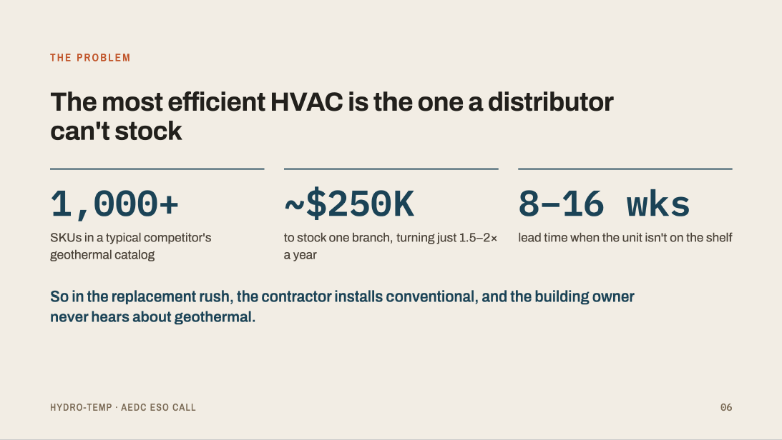

Slide 13


Slide 14
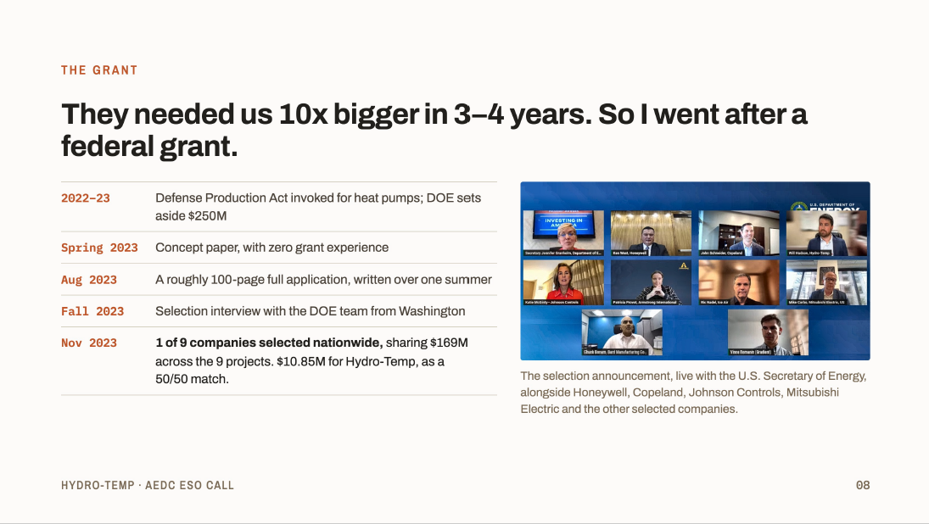

Slide 15


Slide 16
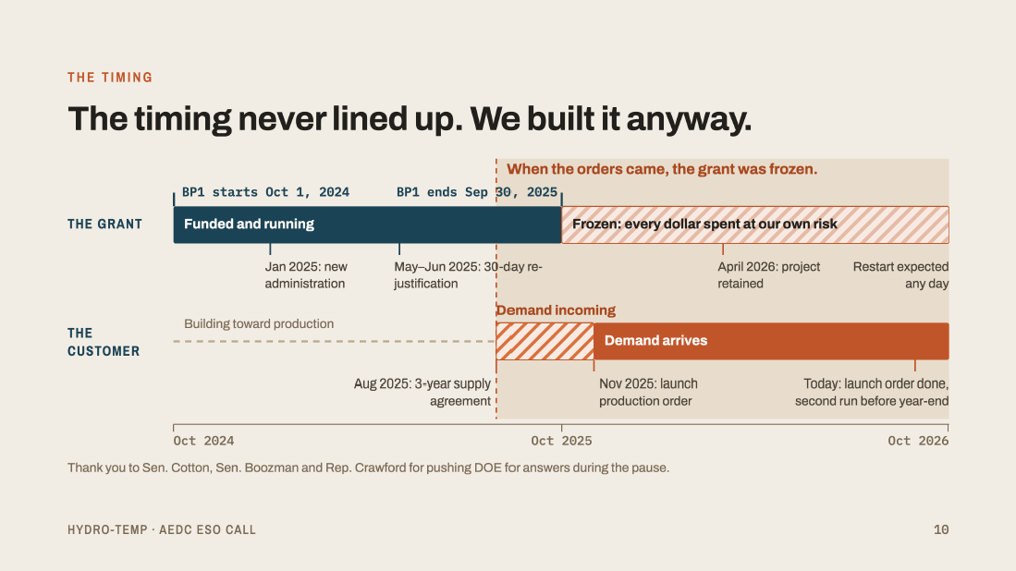

Slide 17


Slide 18


Slide 19


Slide 20


Slide 21

October 2026
Community
ANNOUNCEMENTS

Slide 22

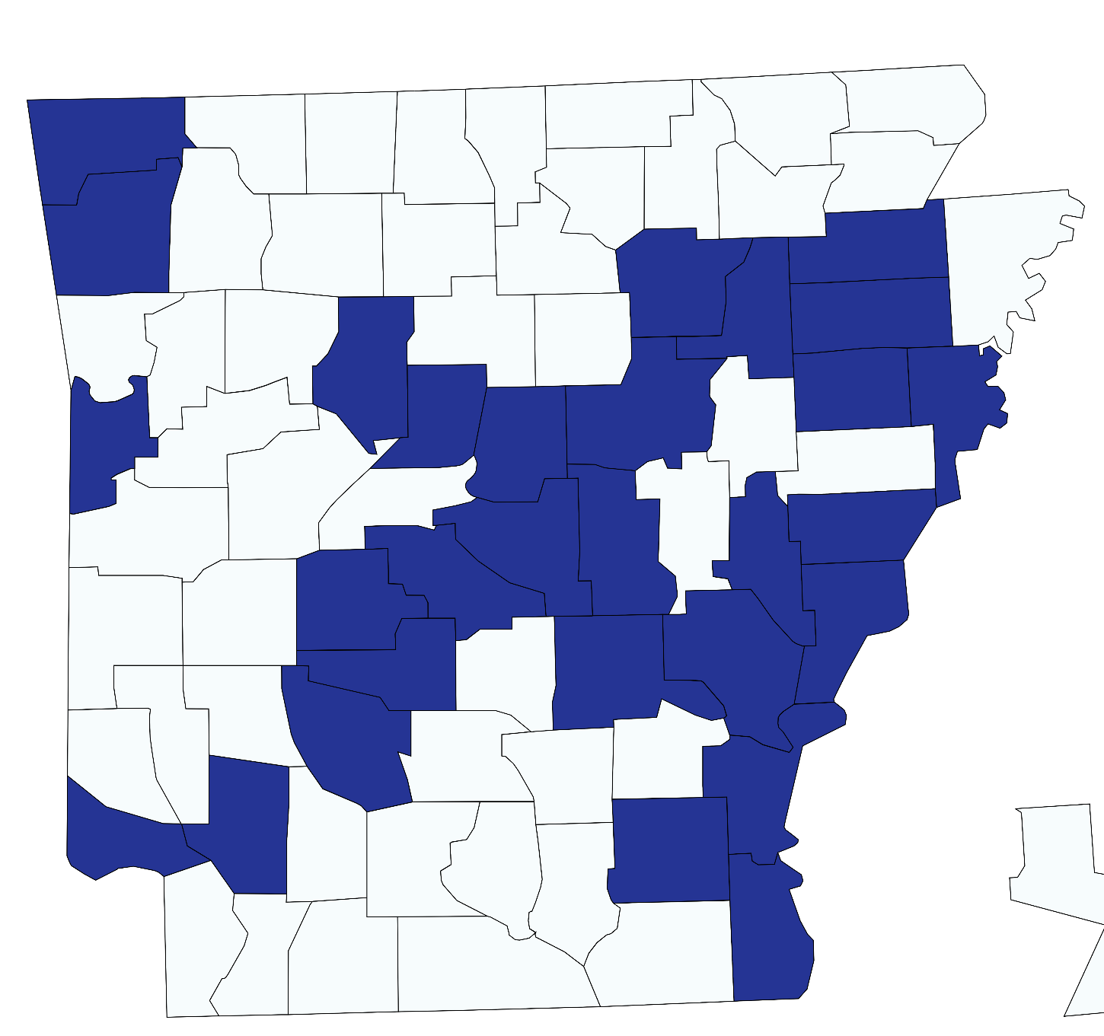
“The Clinton School of Public Service was founded to equip future leaders from all walks of life to be a transformational force
for the public good.”
What our students can do for your organization
Program Planning, Design & Evaluation
Needs Assessments
Best Practice Research
Community-engaged research
Strategic Planning
Feasibility Studies
Grant Writing/Fundraising
Projects
Completed
Statewide
Interested?
Contact Rachel Norris, Director of Domestic Programs, rnorris@clintonschool.uasys.edu
Notes:
RACHEL
Types of research a team might do

Slide 23


Slide 24


Slide 25


Slide 26


Notes:
https://luma.com/hvc7na54

Slide 27

Notes:
https://luma.com/hvc7na54

Slide 28

Notes:
https://luma.com/hvc7na54

Slide 29
Thank you for joining us!
See you next month!
Next meeting will be held November 4th at 10 CT

