Slide 1
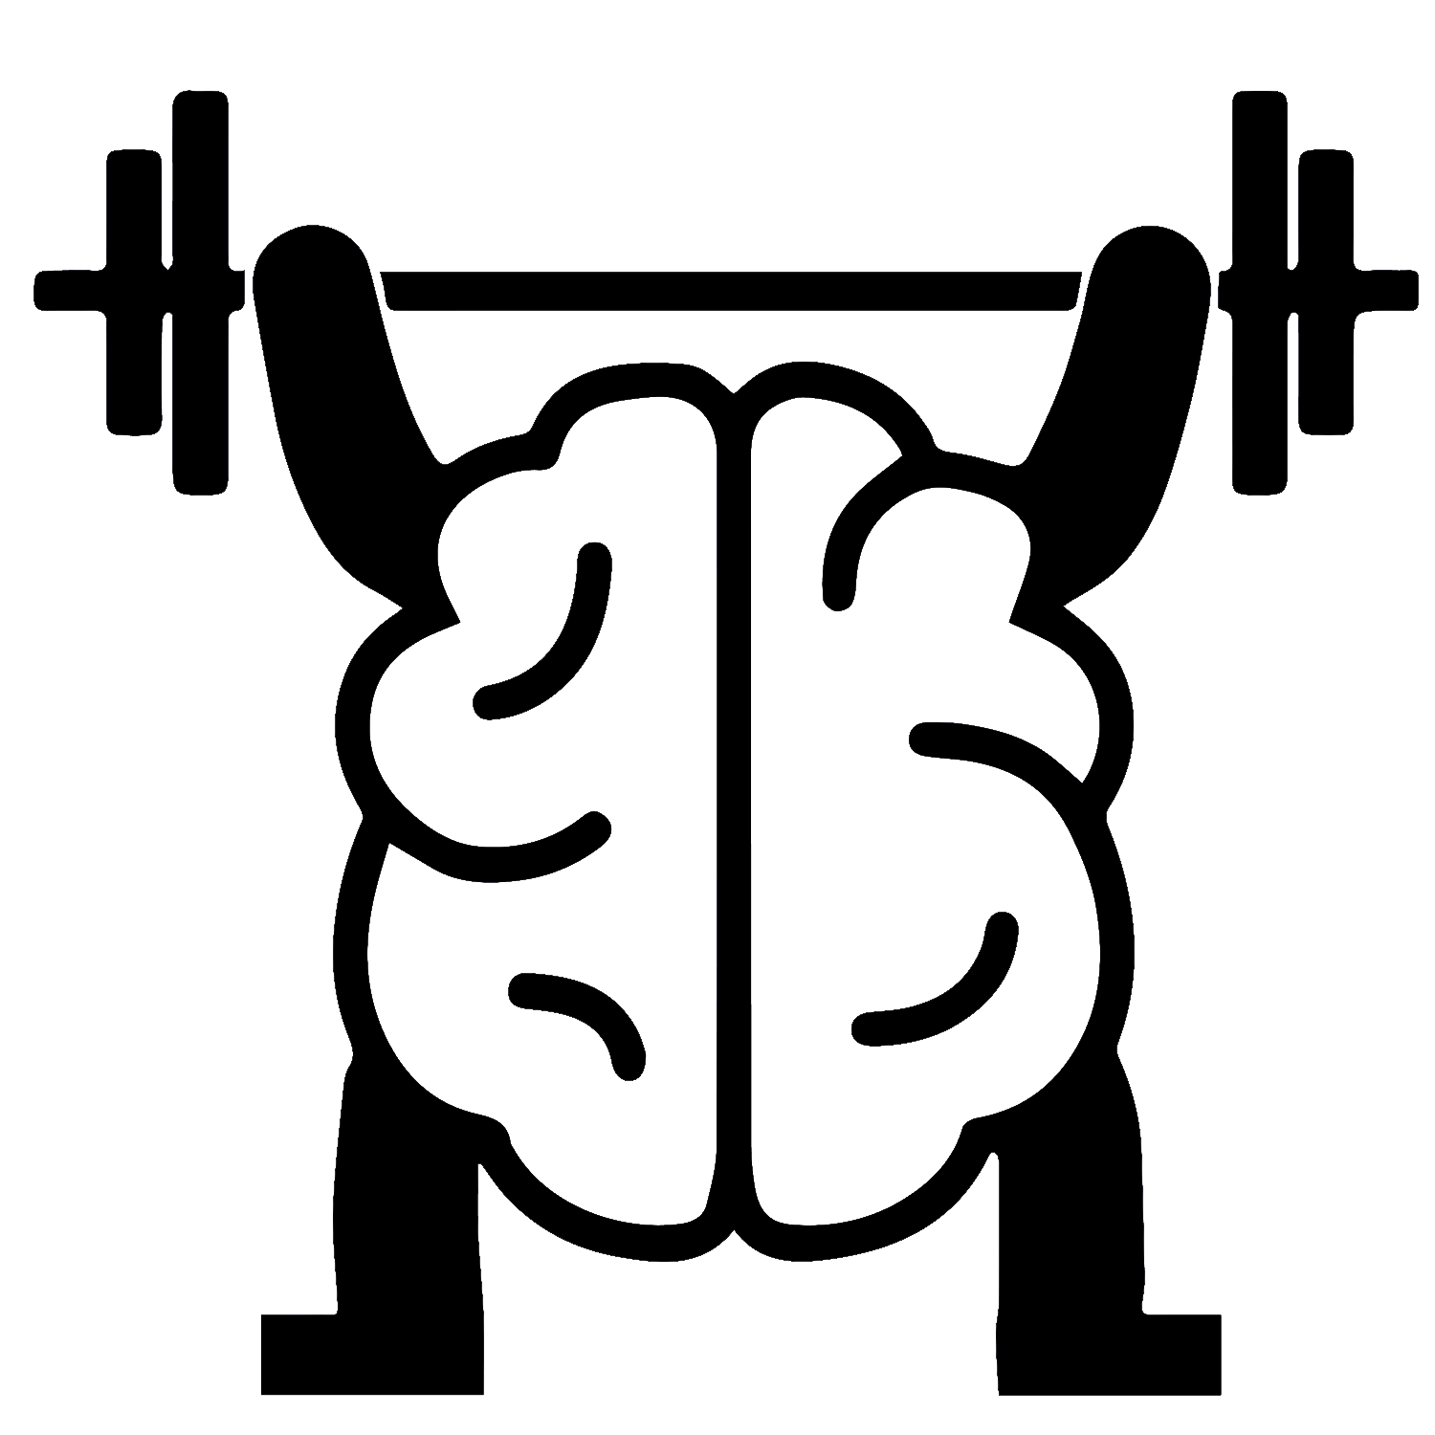
TOYOTA KATA
Daily Practice for
Scientific-Thinking Skill, Mindset & Culture
By
Mike Rother

Slide 2
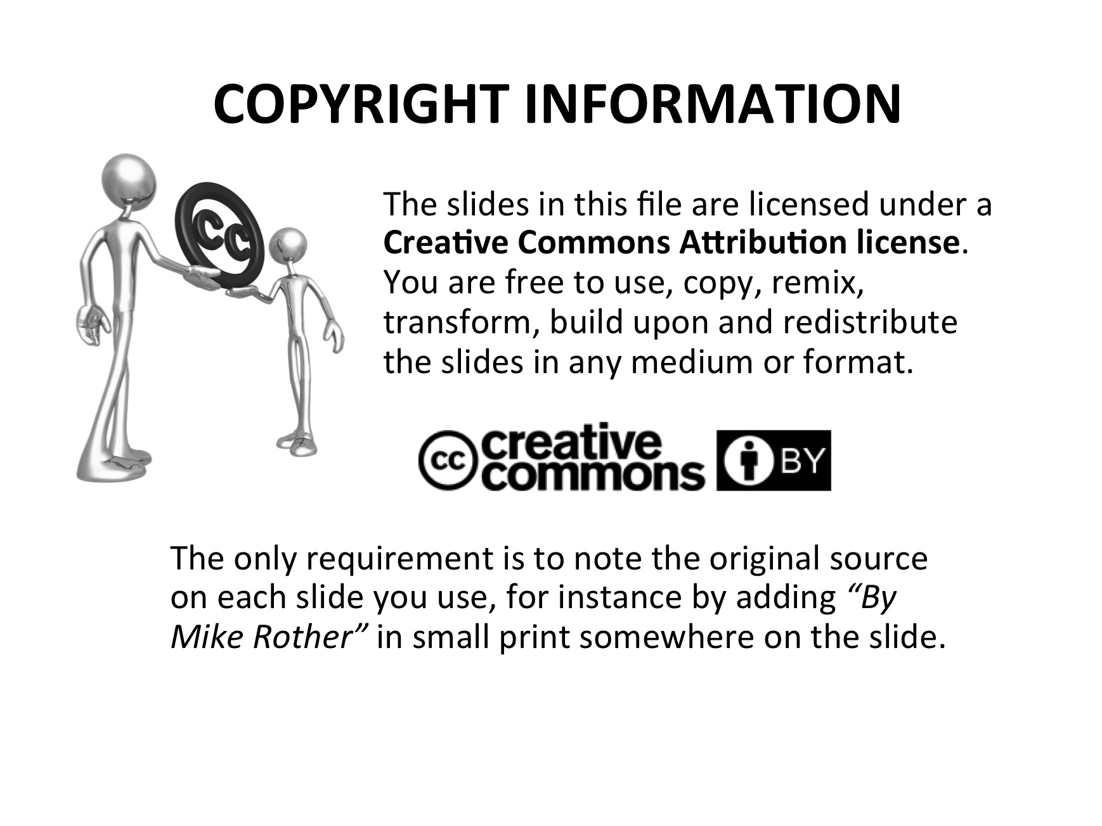
Notes:
Please feel free to use these slides.
Please follow the Creative Commons copyright shown here.

Slide 3
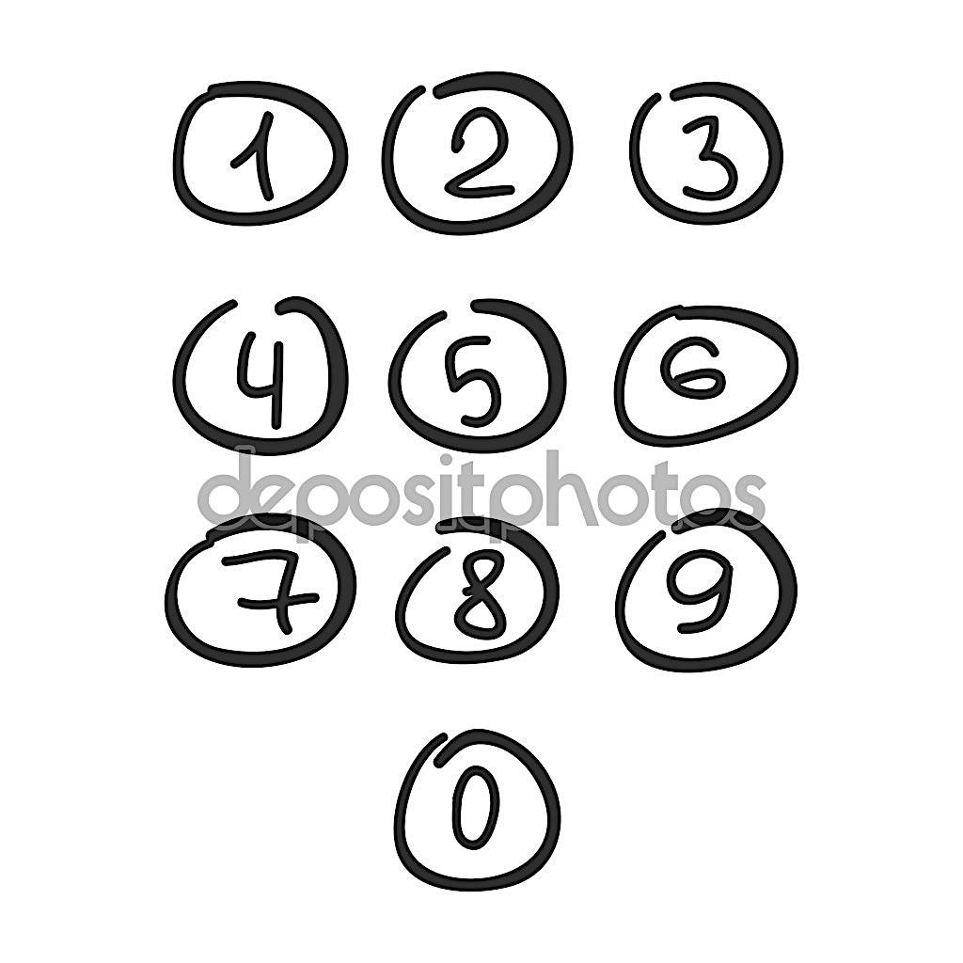


WHAT IS TOYOTA DOING?
We studied Toyota
because of their enduring success as a company
The TK Research Questions (2004 – 2009)
What are the unseen managerial routines and thinking that lie behind Toyota’s success with continuous improvement and adaptation?
How can other companies develop similar routines and thinking in their organizations?
TK Findings
What did we learn?

Slide 4

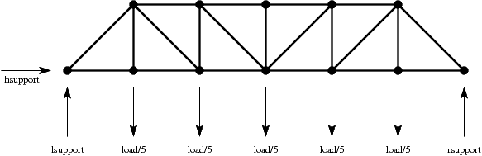


SCIENTIFIC THINKING
As a Foundation for Improvment, Adaptiveness
and Superior Results
Visible
Stuff
• Lean tools & practices
• Toyota's results
Less
Visible
Stuff
A systematic,
scientific way of thinking and acting

Slide 5

WE FOUND A PATTERN AT TOYOTA
The four-step Improvement Kata model
A practical, scientific Way of Improving
1
3
Challenge
Next
Target
Condition
(date)
2
4
Experiment
Toward the TC
Current
Condition
• You can't reach the overall challenge right away.
• The path to the TC is not predictable or straight.
• You experiment to get there.
Notes:
• We studied Toyota and this model depicts what we found.
• Of course there were variations from manager to manager, but overall they think and work like this.
• (Read through the four steps.)
• This way of thinking is a foundation underneath the visible Lean practices at Toyota.

Slide 6

BUT A MODEL ALONE ISN'T ENOUGH
How do you acquire this way of thinking?
1
3
Challenge
Next
Target
Condition
(date)
2
4
Experiment
Toward the TC
Current
Condition
Notes:
• There are other scientific-thinking models like this. Systems Thinking, Design Thinking, Creative Thinking, Evidence-Based Learning, etc.
• But few organizations have adopted them.
• The issue is not having a model, but how to transition to what the models depict. How change our mindset and behavior?
• How do you make it real? That's the hard part!
• That's what the Kata Summit is about.

Slide 7

ONE ANSWER
A Practical Scientific Thinking Pattern
+
Daily Routines of Deliberate Practice
Making Scientific Thinking a Skill
that Can be Learned by Anyone
=
Notes:
• Bringing these two things together is somewhat unique.
• Scientific thinking as a life skill, not just something just for professional scientists.

Slide 8
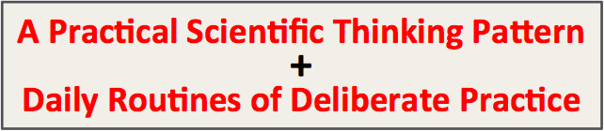

SCIENTIFIC THINKING
What is it, and why teach it
Scientific
Powers

Slide 9
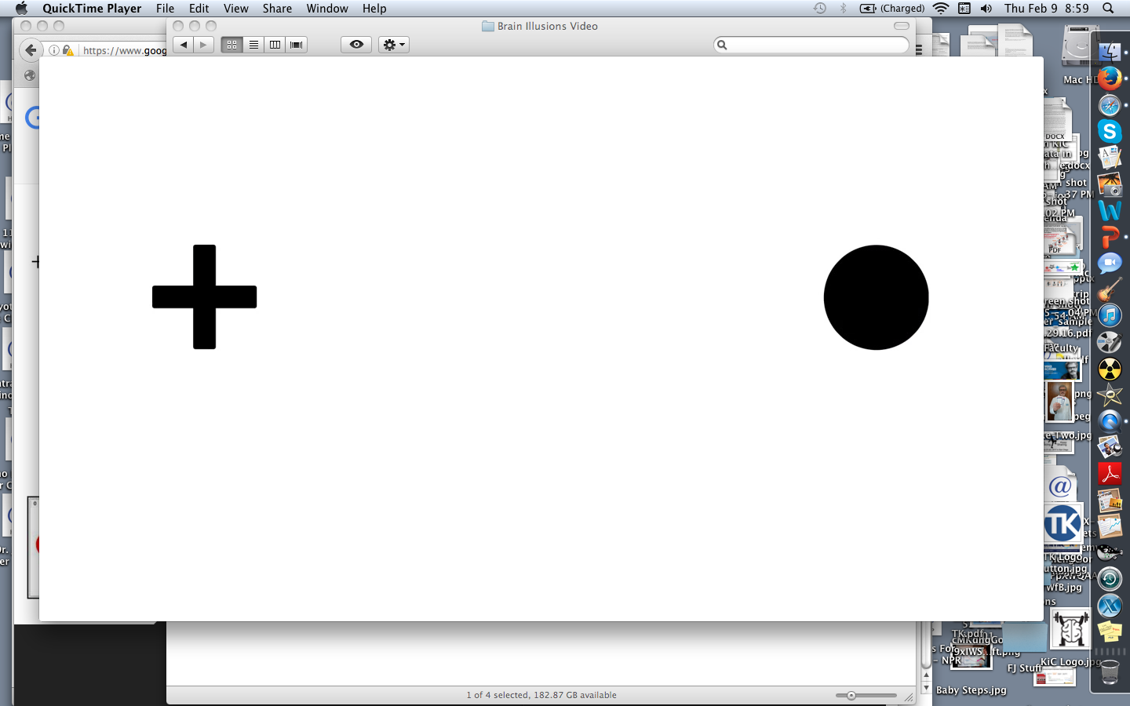
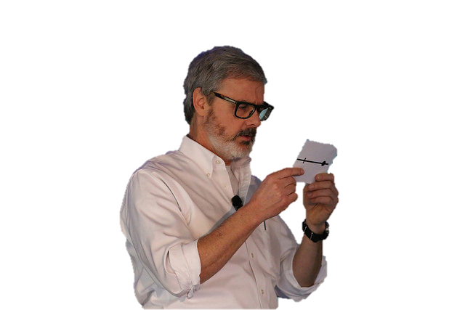
CARD – SIDE 1
• Hold the card in front of you, dot on the left.
• Close your left eye. Stare at the dot with your right eye.
• Move the card in and out while staring at the dot.
• What happens?
Notes:
• Please take this card out of your pouch.
• Hold the card in front of you in this position (dot on the left).
• Close your left eye and stare at the dot with your right eye.
• Move the card in and out until the cross dissapears.
• Why does this happen? (It's our blind spot. You can't actually see what is there.)

Slide 10
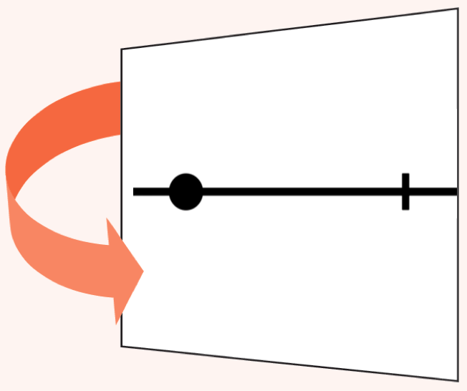
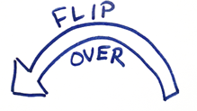
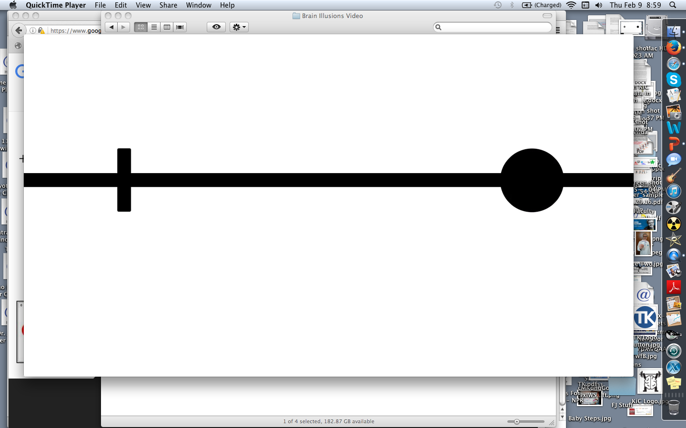
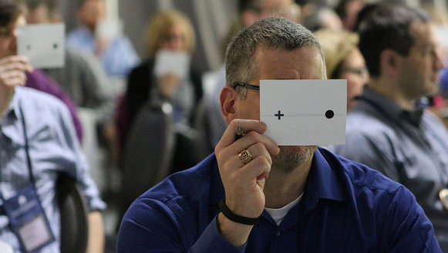
CARD – SIDE 2
• Again: card in front of you, dot on the left.
• Close your left eye. Stare at the dot with your right eye.
• Move the card in and out until the cross disappears.
• What happens this time?
Notes:
• Flip the card over and hold in same position, dot on the left. Same procedure.
• Notice how the brain assumes the line continues, even though you can't see that part of it.
• Interesting that our brain doesn't show the gap, or say, "Can't see. Wait. Need more information."
• Brain doesn't show you unfiltered reality, it interprets reality based on patterns, your library of prior experiences and your predispositions.

Slide 11
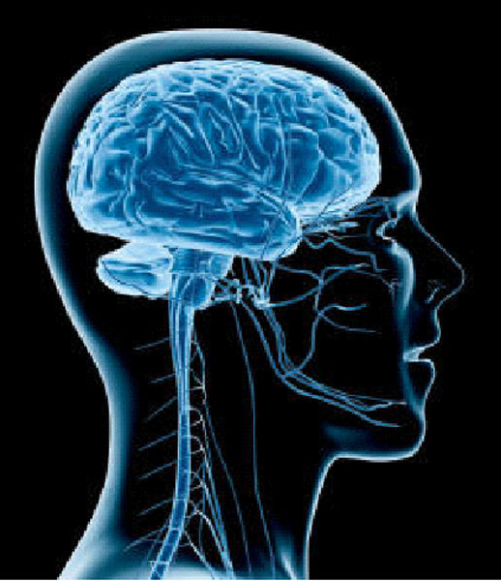
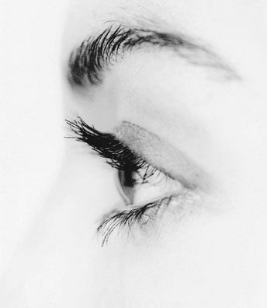
THE BRAIN MAKES ASSUMPTIONS
Our brain creates feelings of certainty
based on the bits of information it receives
to
Jumping
Conclusions
OUR BRAIN FILLS IN THE BLANKS
(automatically)
Current
Knowledge
Threshold
We often don't notice
a knowledge threshold because our brain is filling in blanks
Notes:
The brain quickly and unconsciously (to us) jumps to conclusions.
That may sound negative, but...

Slide 12
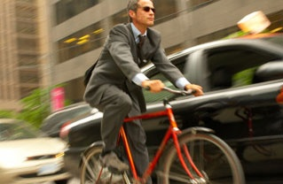
THIS ASSUMPTION MECHANISM
HELPS US GET THROUGH THE DAY
Our survival depends on it
Better-safe-than-sorry cognitive mechanism
Faster!
Saves limited cognitive resources
Child's brain = exploring, but helpless.
Adult brain has many learned neural paths = performing.
Notes:
• Child's brain is exploring to learn. But a child is still fairly helpless. Can't ride a bike, drive a car, navigate a city, etc.
• Adult brain uses what it learned from past experiences to help you navigate the world, but has less of an exploratory mindset.
• On balance I'd rather have the jump-to-conclusions mechanism than not.

Slide 13

BUT IT ALSO CAUSES PROBLEMS
We feel certain and make faulty decisions
IUMRING TQ GQNGIUSIQNS
IUMRING TQ GQNGIUSIQNS
Notes:
• Remarkable that you can read the line without seeing all of it.
• But we also make mistakes that way.

Slide 14
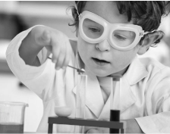
A COUNTERMEASURE:
SCIENTIFIC THINKING
"Let's try it and see"
A routine of intentional coordination between what we predict will happen next, seeing what actually happens, and adjusting based on what we learn from the difference.
What we
expect
to happen
What
actually
happened
Learning

Slide 15

IT'S A LEARNING CYCLE
A process for acquiring knowledge
that's sometimes called "Plan-Do-Check-Act"
EVALUATE
Compare outcome
and prediction.
What did you learn?
PREDICTION
What are you going to do, and what do you expect?
ACT
PLAN
CHECK
(Study)
DO
DATA
Observe and
measure what happens
TEST
Try it.
Take the step.
Scientific thinking may be the most effective means we currently have for navigating through unpredictable territory toward challenging goals.

Slide 16
LET'S TRY THE SCIENTIFIC APPROACH
What will be the next number in this series?
Please write down your answer
2, 4, 6, 8, 10, 12, ?

Slide 17
ANSWER
2
2, 4, 6, 8, 10, 12,
Notes:
Use the back of your five Coaching Kata questions card (reflection section):
• What did you expect?
• What actually happened?
• What did you learn?

Slide 18
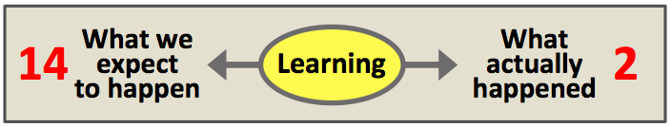
EXPERIMENTING
2
2, 4, 6, 8, 10, 12,
• Notice that we are learning via a prediction error:
- What theory did we have?
- What if the correct answer had been "14"?
• What theory do we want to test now?
• If we test 100 times will we be certain?
Notes:
• What theory did we have? → "Going up by 2's"
• If the answer had been 14, it simply adds evidence to what we already thought.
• With this result, what theory do we have now? What theory do you want to test now? → "Repeats after 12"
• If we test this 100 times and each time it repeats afer '12' are we certain it will always be that way? (Nope. Science is never 100% certain.)

Slide 19
AT A KNOWLEDGE THRESHOLD
WHAT WOULD BE A GOOD RESPONSE?
2, 4, 6, 8, 10, 12, ?
Threshold
of Knowledge
The threshold of knowledge is our Learning Edge,
where your next experiment should take place.
And don't feel so bad about prediction errors!
Notes:
• When you're at a knowledge threshold, do an experiment to see further.
• Typical meetings where we argue about what we believe will happen.
• Argue instead about the next experiment.
• Good experiments include keeping the ramifications of prediction errors small.

Slide 20
THE IMPROVEMENT KATA IS A PRACTICAL PATTERN OF SCIENTIFIC THINKING
Direction
or
Challenge
Next
Target
Condition
(date)
Threshold of Knowledge
Current
Condition
Experiments
At the Current
Knowledge Threshold

Slide 21

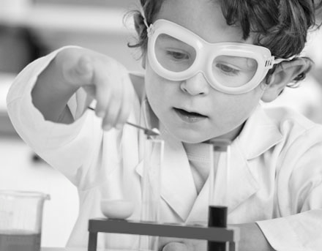
Scientific
Thinking
is Learned
Born?
Learned
It's not our default mode as adults. Adults are bad at scientific thinking, due to all those learned neural paths.
OK... HOW?
Notes:
We need that protective jump-to-conclusions mechanism.

Slide 22
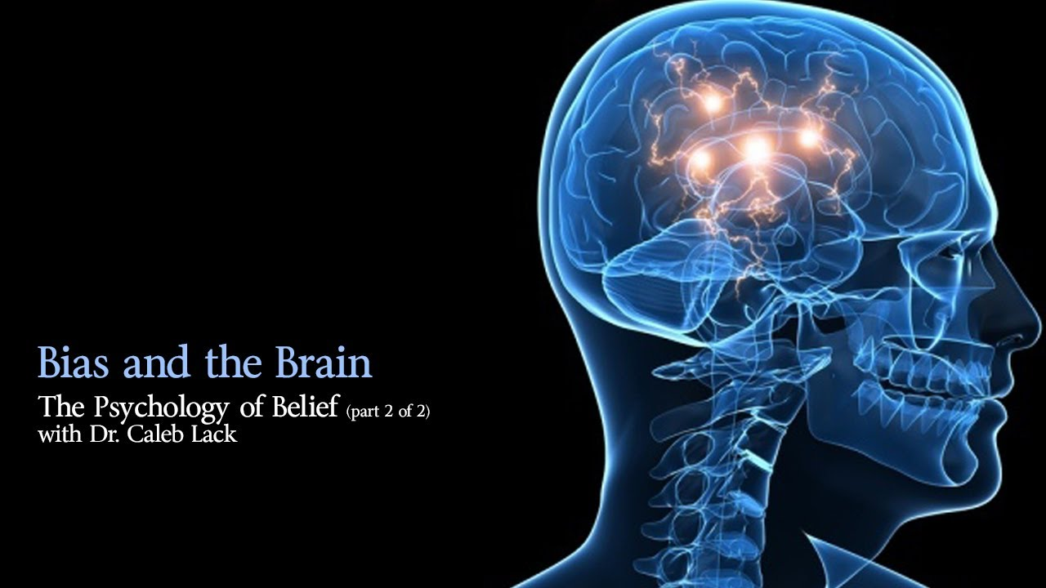
HOW DO YOU DEVELOP
NEW SKILLS & MINDSET?
Notes:
(Part 3) Now let's talk about the other piece.

Slide 23

WHAT DOES IT TAKE TO LEARN NEW SKILLS
AND CHANGE OUR THINKING?
Take a moment... please cross your arms

Slide 24
LET'S TRY JUST A SMALL CHANGE
Now re-cross them the other way
Notes:
Not even a big change.

Slide 25
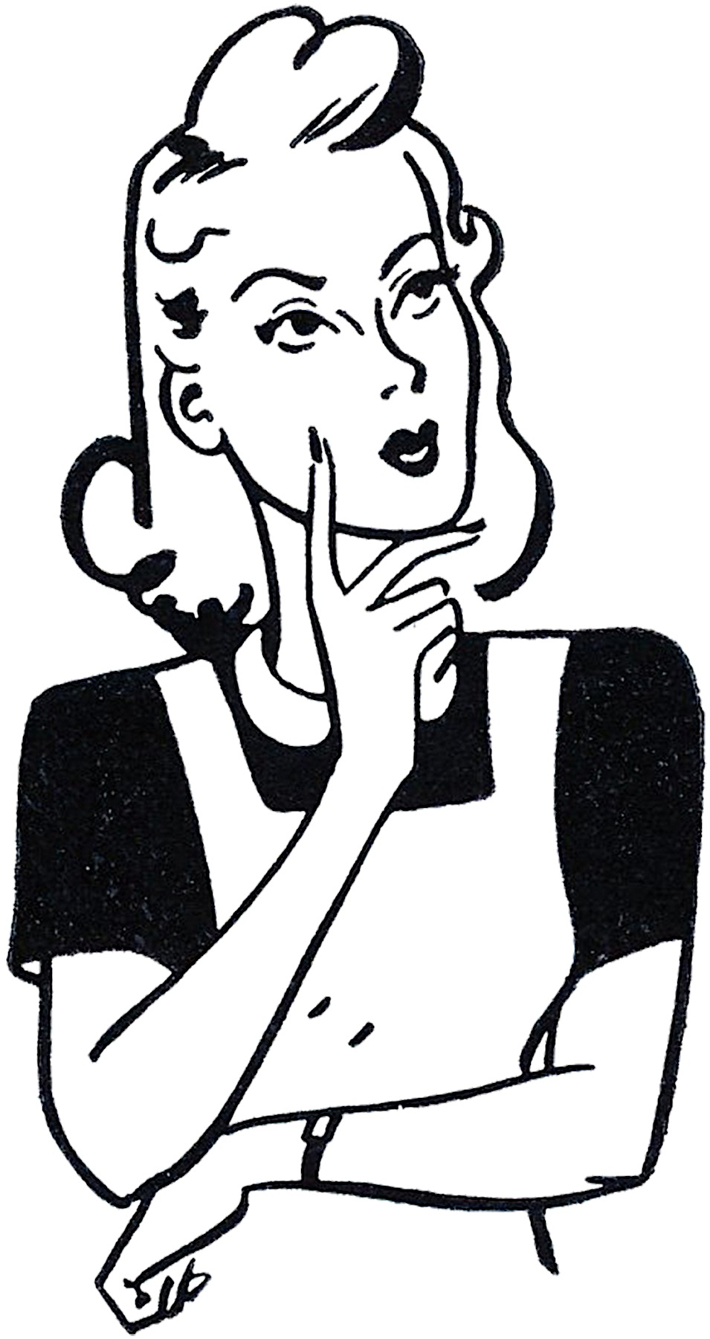
HOW DID IT FEEL THE SECOND TIME
COMPARED TO THE FIRST?

Slide 26


SECOND TIME
Awkward
Slow
Unnatural
Stiff
Uncomfortable
Difficult
It feels wrong
Had to think about it
What's
going on here?

Slide 27


OUR THINKING PATTERNS ARE IN A LOOP
We've practiced folding our arms for decades
MINDSET
BEHAVIOR
Every time you think or do something, you are more likely to
do it again, because it writes & strengthens neural pathways
Notes:
You've been practicing folding your arms a certain way for decades.

Slide 28


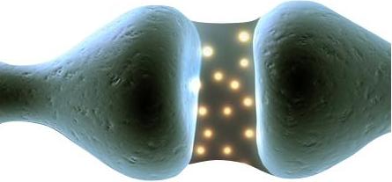
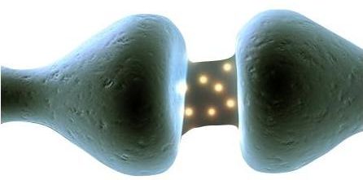
WHY THE 2nd TIME
FEELS DIFFERENT
2 %
20 %
The brain strongly favors our
practiced neural pathways, to
conserve energy and for safety
Brain
Size
Brain's Energy
Needs
Fast & Efficient
Neural Pathways
Our Habits
Slow and Inefficient
Neural Pathways
New Ways
"Highways" in our brain. Takes little attention and energy.
Takes more attention
and energy, at first

Slide 29

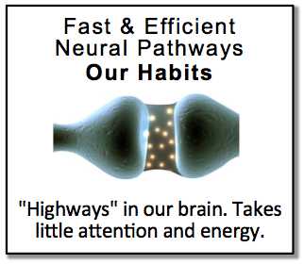



YOU CAN'T WIN THIS WAY
Lecture
Trying to fight existing neural highways usually doesn't work.
The learner will almost always automatically stick with or revert back to their old way of doing things. It's physiological.
We don't think and act a certain way because we lack information. We do so because it's a habit.
Notes:
Sound familiar?

Slide 30

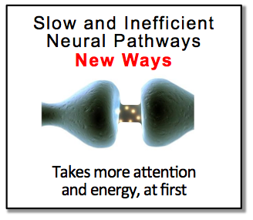
DON'T TRY TO FIGHT EXISTING NEURAL HIGHWAYS, BUILD NEW ONES
What can work: Deliberately practicing a new routine.
Focus on developing new neural pathways, i.e. building new habits.
Grow new thinking, that eventually replaces the old
Notes:
• This is the Improvement Kata / Coaching Kata strategy.
• Instead of fighting the existing neural highways in your brain, develop new ones to replace them.

Slide 31


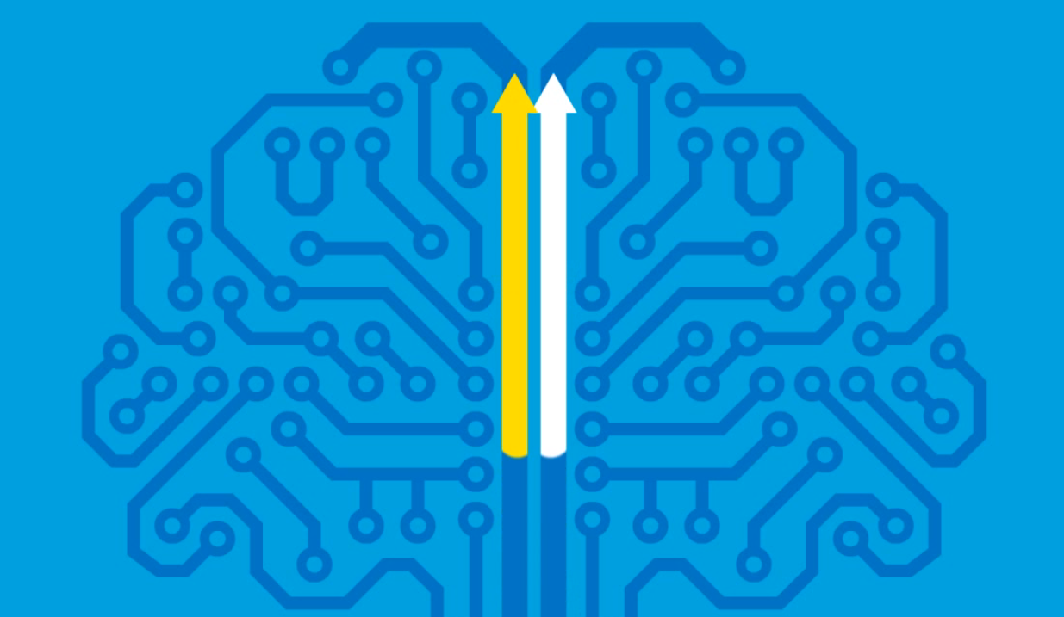
HOW WE ACQUIRE NEW SKILLS & MINDSET
(2 minutes)

Slide 32
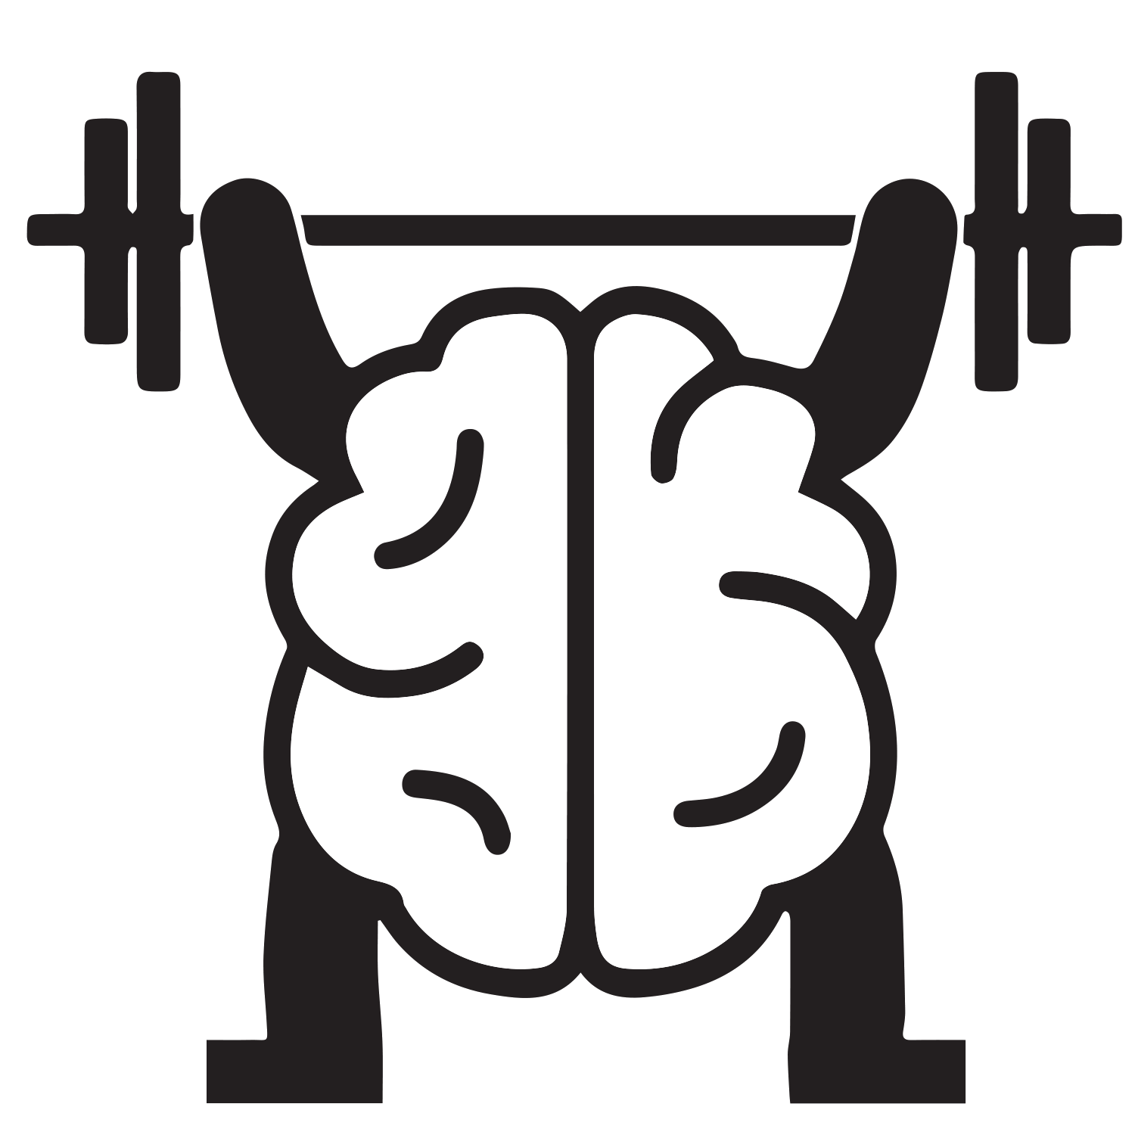


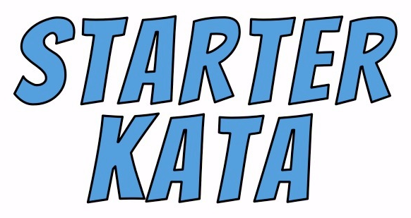
THIS IS WHERE KATA COME IN
More Scientific
MINDSET
More Scientific
BEHAVIOR
It's not just repetition:
- Practice the right pattern,
i.e. correct errors (need a coach).
- Takes some positive emotions.
Notes:
Not just repetition:
- have to practice the right new pattern, i.e. correct errors (need a coach)
- have to periodically have some positive emotions, like, "Hey, I'm getting better at this."

Slide 33
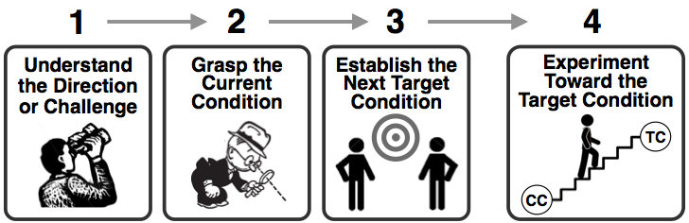
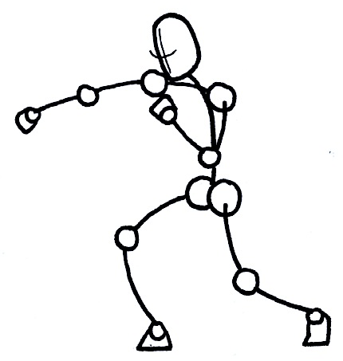
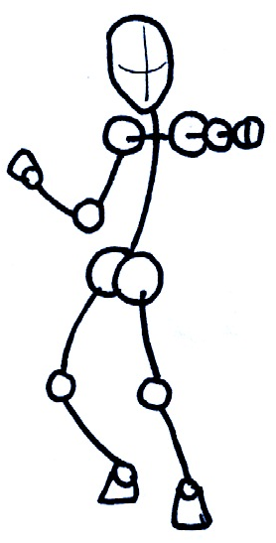
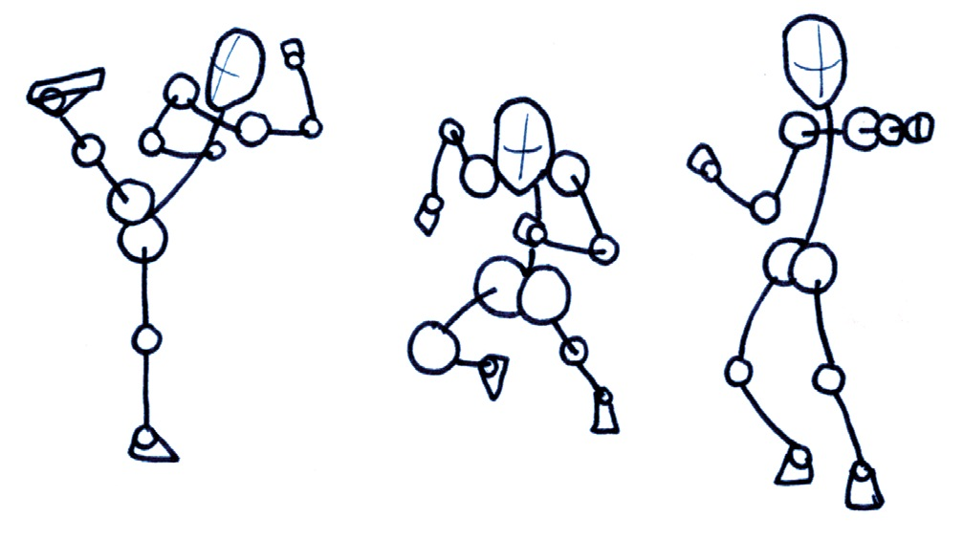
STARTER KATA
There are simple practice routines for each step of the IK model, to learn fundamental skills. They're a starting point for any individual, team or organization who would like to develop a scientific-thinking mindset and approach.
The IK
Model
STARTER KATA to begin to operationalize the IK pattern
Notes:
Example Starter Kata from the Netherlands, to get drivers to look before they open the car door (bicycles!).
- "Look before you open the door!" ☹ (just saying this doesn't change behavior)
- "Open door with right hand" ☺ (a Starter Kata to make a certain behavior a habit)

Slide 34
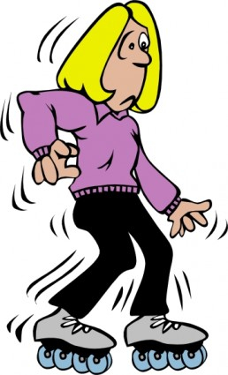
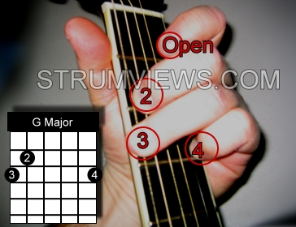
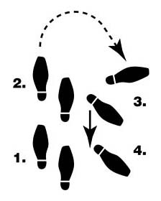
STARTER KATA = AIDS FOR FIRST PRACTICE
They're building-block practice routines that help you learn fundamentals and adopt new ways of acting and thinking
• Not a problem-solving method. They're practice
routines to make you a better problem solver.
• Doesn't replace improvement methods you have.
• Can't implement Kata, you can only practice them.
Notes:
• Not a problem-solving method, but practice routines to make you a better problem solver.
• Work with any improvement methods you already have. Doesn't replace them.
• Can't implement Kata. Can only practice Kata.
• Optional: Discuss 2 error modes.

Slide 35
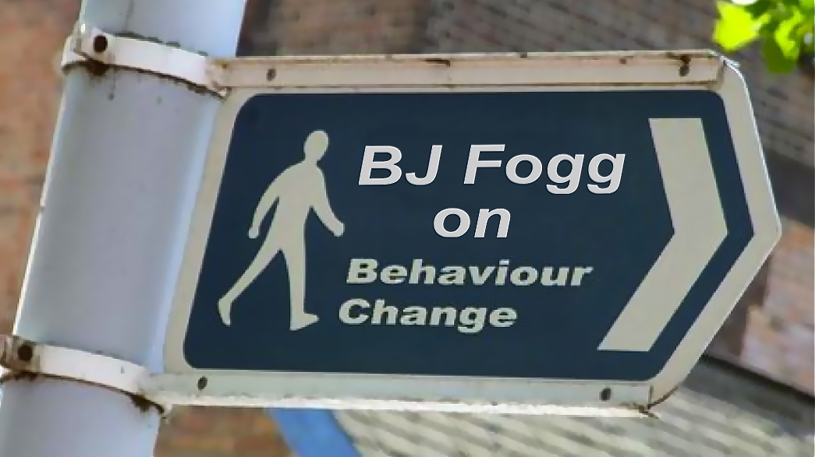
DON'T START WITH A 20-MILE RUN!
(4 minutes)

Slide 36
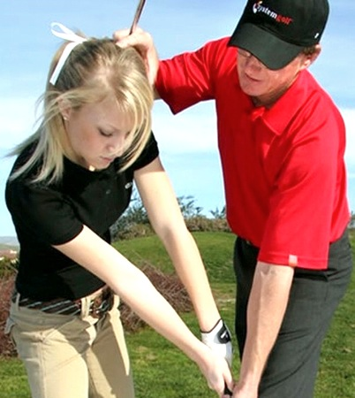
THERE'S ALSO A COACHING KATA
Practice assessing the learner's current practice and giving
corrective, situational feedback to each learner
CK
Practicing Coaching Skills
(The Manager)
IK
Practicing Improvement
Skills
Coach
Learner

Slide 37
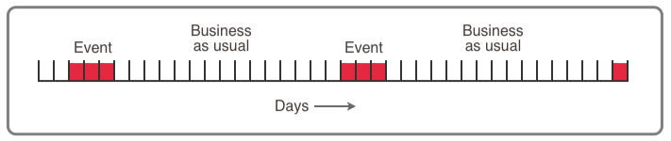
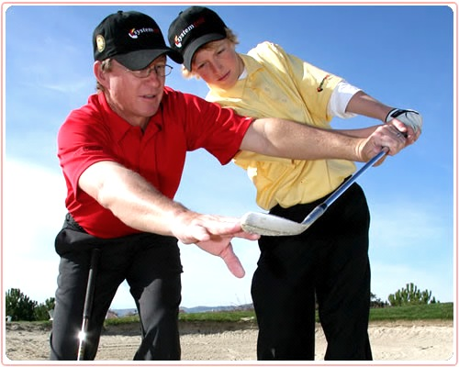
DAILY PRACTICE
20 minutes a day is better than two hours once a week. If you practice only periodically and the rest of the time itʼs business as usual, then what you are actually practicing is business as usual.
This means:
Practice should be part of daily work.
Coaches should be line managers, because they are there every day.
IK/CK Coaching
is one-on-one

Slide 38

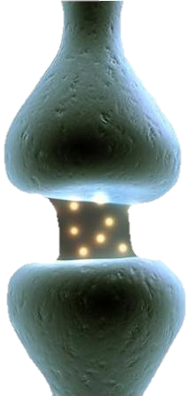
THIS IS WHAT
YOU WANT TO FEEL
It means you're building new neural pathways (learning)
Awkward
Slow
Unnatural
Stiff
Uncomfortable
Difficult
It feels wrong
Had to think about it
This feeling
indicates learning
Notes:
It was a Homer Simpson moment to realize that this feeling is actually a positive indicator of starting to learn new skills.

Slide 39
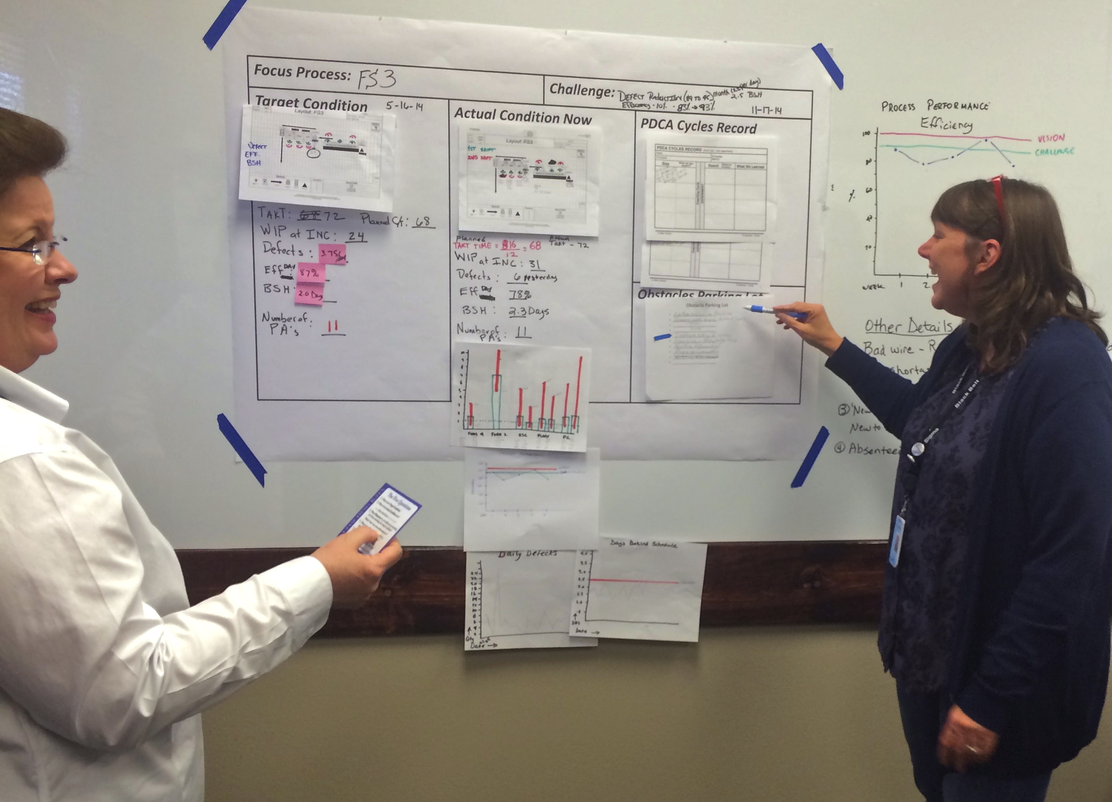


Learner's Storyboard
Challenge
Experimenting
Record
Current
Condition Analysis
Target
Condition
Definition
Obstacles Parking Lot
LEARNER
COACH
Block
Diagram
Run Charts
Daily Coaching Cycle
≤ 20 Minutes a Day
Notes:
'Coaching Cycle' ≤ 20 Minutes a Day

Slide 40
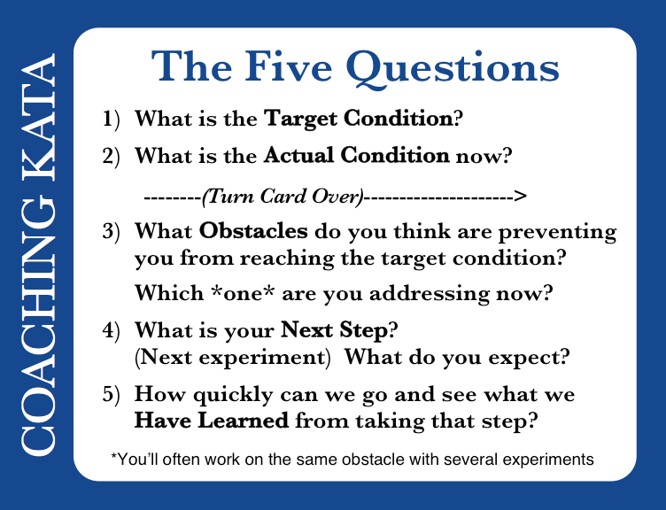

LEARNER
COACH
The Five Coaching Kata Questions
The headings for
a coaching cycle
Notes:
The five Coaching Kata questions are the main headings for conducting a coaching cycle

Slide 41
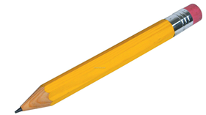
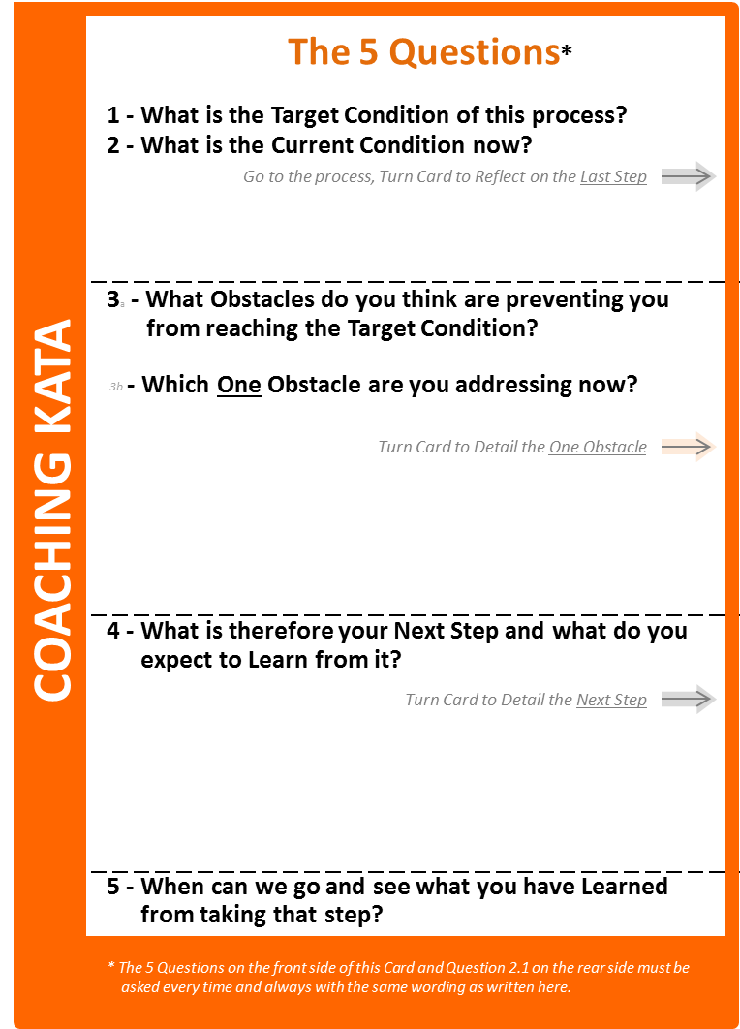

THEN GO BEYOND THE FORMAL KATA
Develop your own way - by building on the fundamentals
The Starter-Kata Coaching Questions
Coach's notes & clarifying questions
1) What is the Target Condition?
• Is the target condition connected to the challenge?
• What do you want to be happening? • No verbs!
• Measureable? • Not 'lack of something' • Achieve-by date?
2) What is the Actual Condition now?
• Numbers, not opinions. • Can you show me? • How do you know? • How did you get the data? • Is there a run chart?
What did you plan as your Last Step?
What did you Expect?
What Actually Happened?
What did you Learn?
• What was being tested?
• Is the Experimenting Record filled in?
REFLECTION
• Was this written down? • Just read it!
• Only facts & numbers. • Are the numbers written down?
• Is there a run chart? • What is different than expected?
• Did the Learner really reflect on this?
3) What Obstacles do you think are preventing you from reaching the target condition?
Which *one* are you addressing now?
• Is the Obstacles Parking Lot up-to-date?
• True obstacles (variation), not action items or lack of a perceived solution.
• Where does this problem occur? • Can you show me?
• When does this problem occur?
4) What is your next step? (Next experiment)
What do you expect?
• What is the current knowledge threshold?
• Did what was learned in the last experiment frame this one?
• Is expectation written down? • Please read it.
• What numerical outcome do you expect?
• How will you measure it?
• How many cycles do you plan to measure?
5) How quickly can we go and see what we Have Learned from taking that step?
• Strive for cheap and fast experiments
• Can we run this experiment today? Right now?
• When is the next coaching cycle?
• Accompany the Learner if necessary.
Starter Kata
Additional clarifying questions that this coach is adding
Notes:
• This coachin is moving beyond the Starter Kata.
• As long as the fundamental pattern of your Starter Kata remains.
• You're going to hear about various evolutions of practice at the Kata Summit.

Slide 42
SUMMARY
Knowing isn't the same as doing. Benchmarking is not enough to make change happen.
Scientific thinking is a good way to navigate, but it is not our default mode.
Skills, habits and mindset are wired in our brain.
You can practice Starter Kata (with some coaching) to help wire your brain for scientific thinking.
You can also modify an organization's culture this way, with managers as the coaches.
Notes:
The last point is what Toyota is doing.

Slide 43
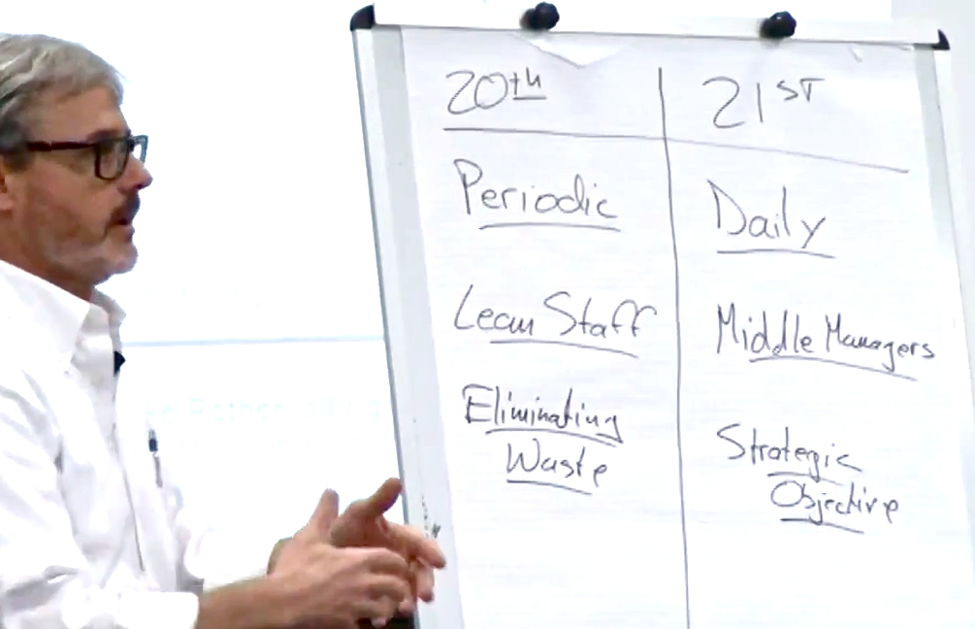
A SHIFT TO “21ST CENTURY LEAN”

Slide 44
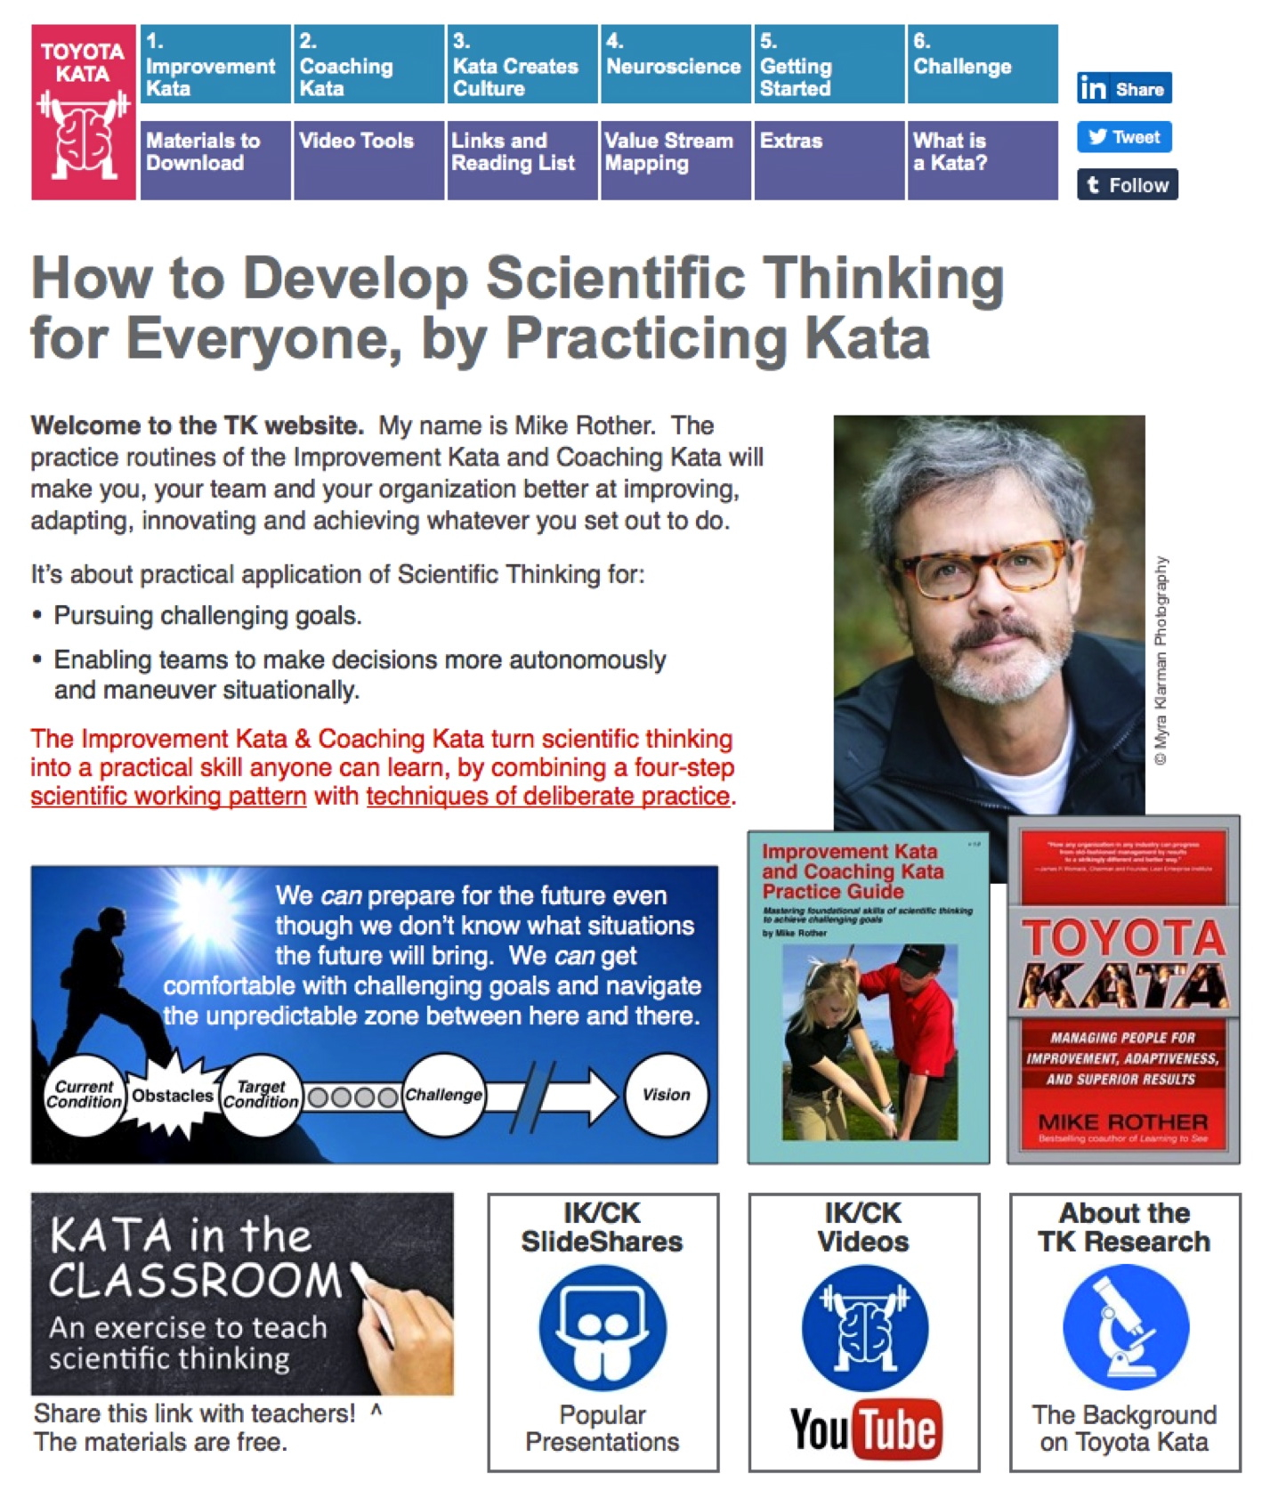
THINGS YOU CAN DO AFTER TODAY
TK Website: Info, Videos, Materials

Slide 45
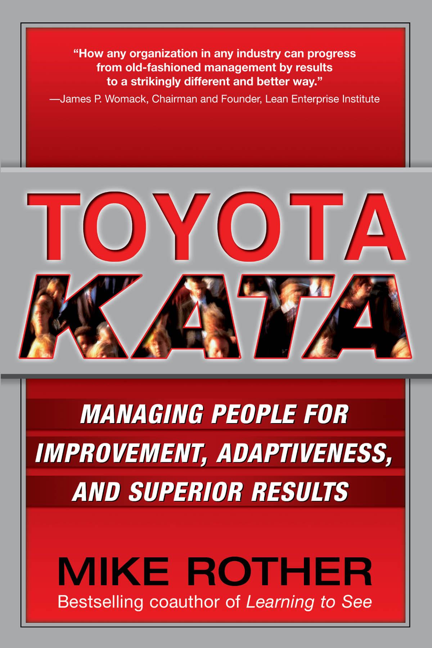
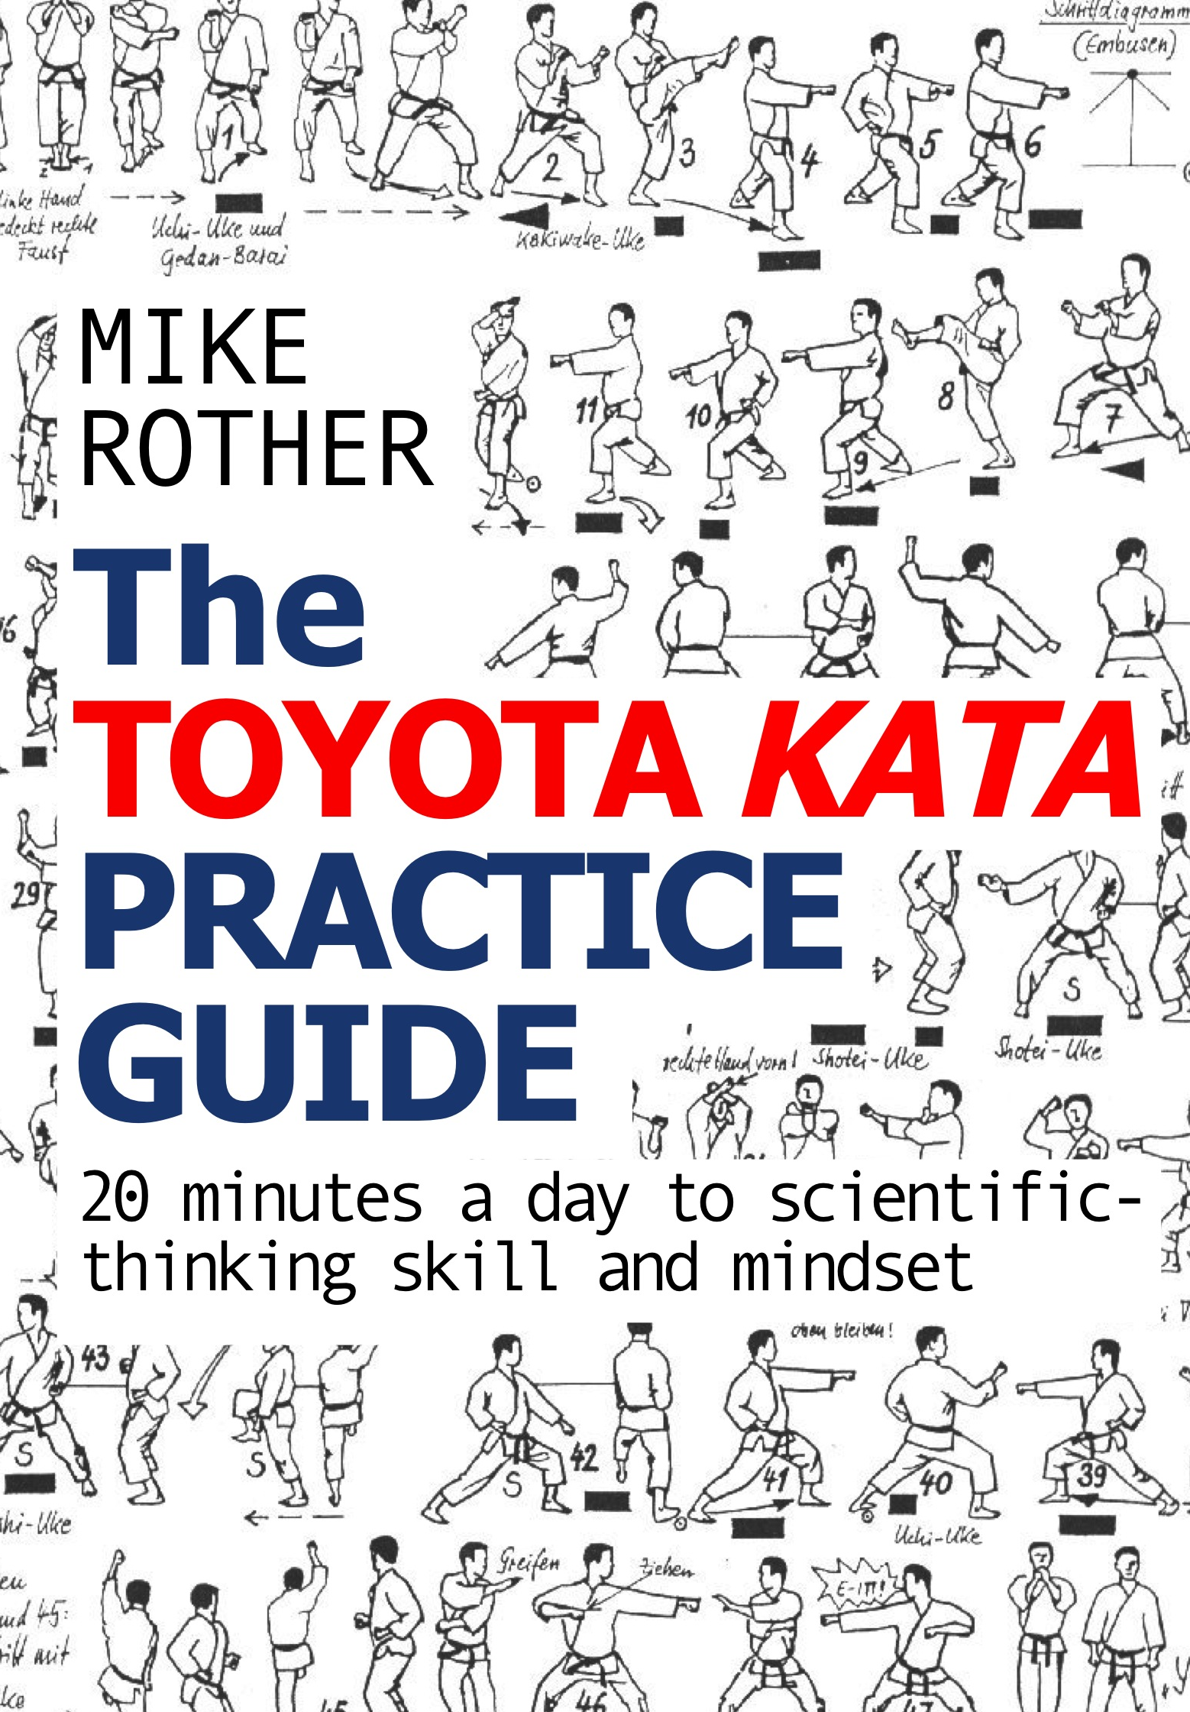
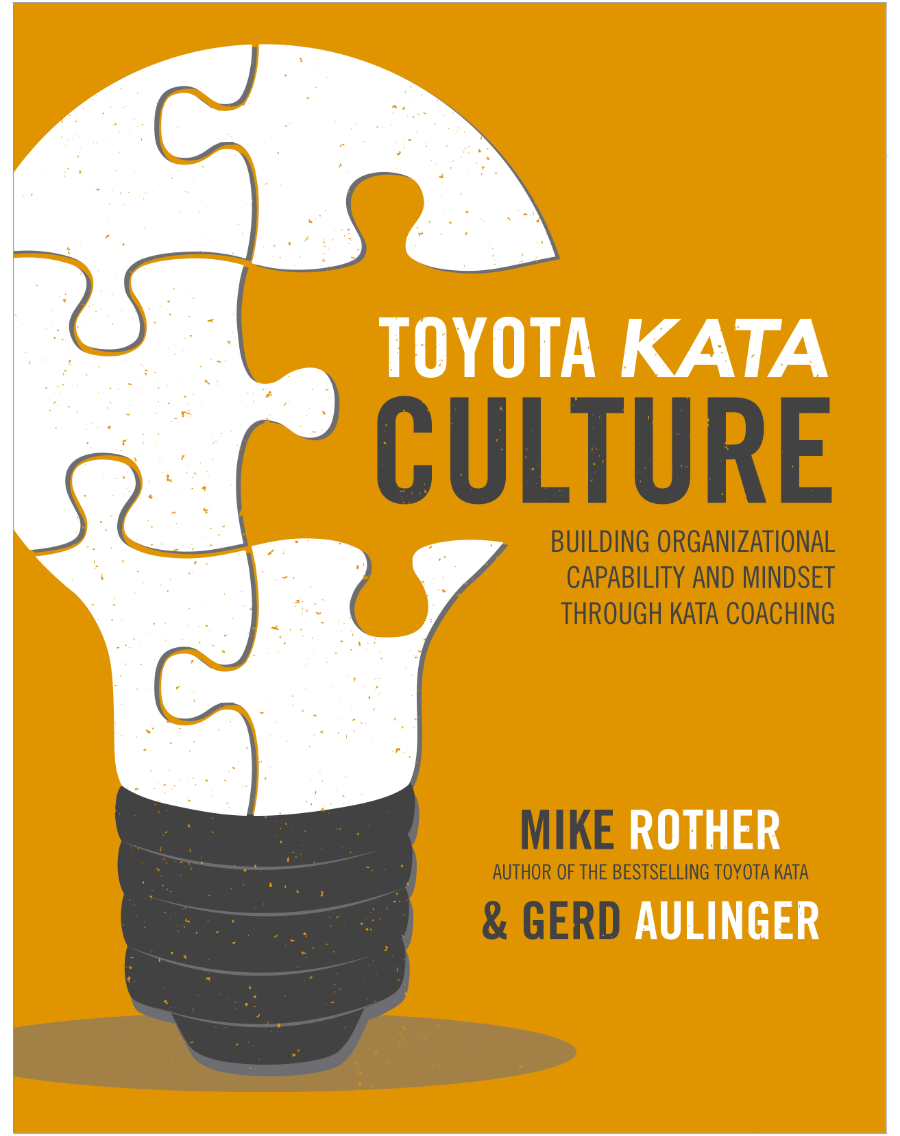
AFTER TODAY
TK Books
October 2017
May 2017

Slide 46
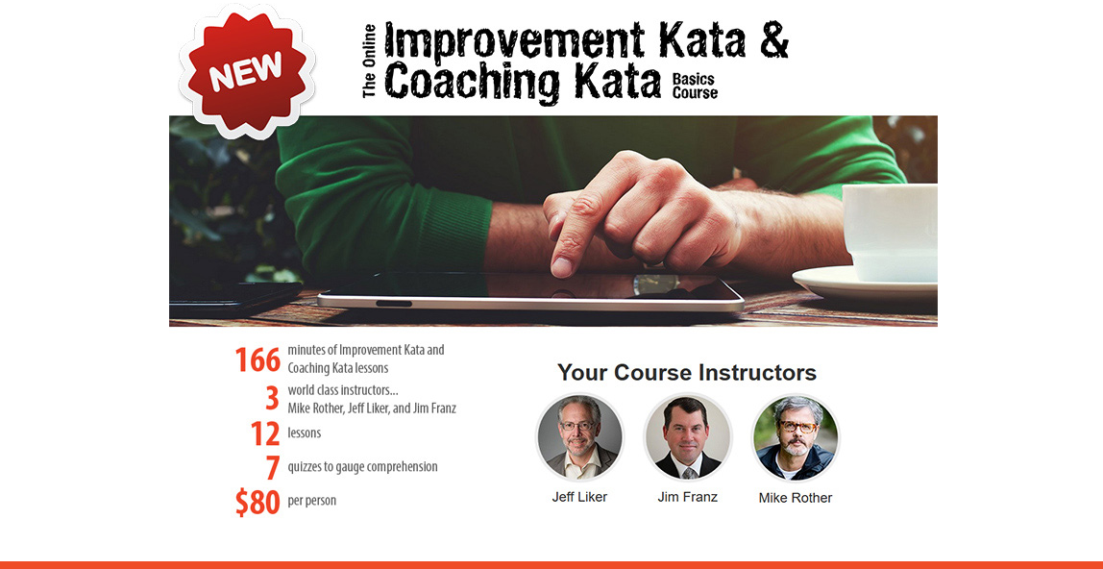

ONLINE IK/CK BASICS COURSE
Contact Bill Kraus at Arkansas Manufacturing Solutions
for access to the online course!
A way to get the Kata basics, so your practice can be better
Notes:
• Interactive way to get the basics, so your practice will be better.
• Compact and inexpensive, to make it accessible.

Slide 47
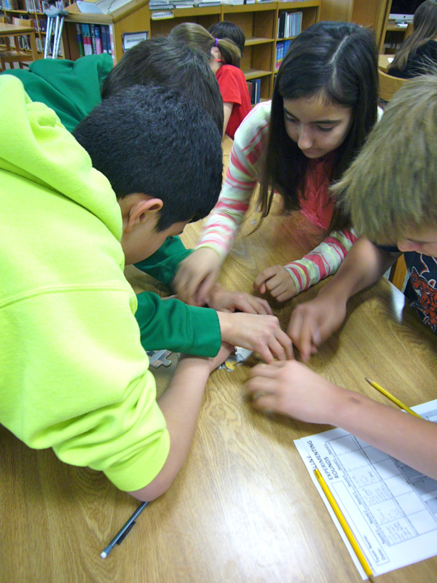
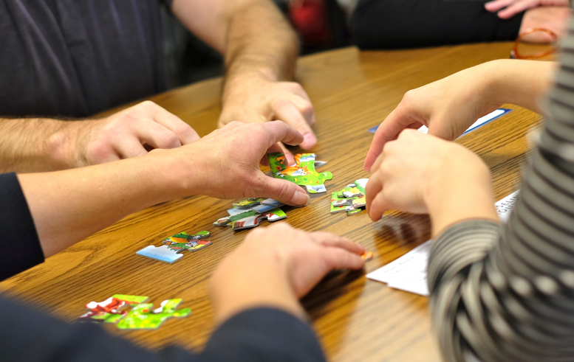
AFTER TODAY
Kata in the Classroom
www.katatogrow.com
Run the exercise in your company and invite some teachers.
Takes ~ 90 minutes.
Notes:
KiC: Run in your company and invite local teachers to join you. Evenings might be the best time for teachers.
KPD: Have IK/CK practitioners from your region present + do the KiC exercise. (Lean Consortium, MEP Center, other group)

Slide 48




Best wishes
for your practice!

Slide 49
Notes:
Copier template for blind spot cards (Side 1).

Slide 50
Notes:
Copier template for blind spot cards (Side 2).

